Slide 1
NFT Market Analysis: Ethereum versus Hedera
DLT Foundation

Slide 2
Agenda Today
A General Theory of NFT Liquidity and Pricing
A general model of digital art
Bridge NFT liquidity to prices and investment return
NFT Liquidity Analysis: Ethereum versus Hedera
Hedera NFT Data Overview
Compare NFT on Hedera versus Ethereum
Royalty Fees For Hedera NFT
Data Processing for Hedera Network and NFT Market
HKU NFT Project Research Team (in Chinese)
AI + NFT --- Application to AI Design
Hedera API Usage
HKU-NFT Project --- Customized Data Services
Education Material of NFT

Slide 3
Hedera NFT Data Overview
A decentralized public ledger using a leaderless, asynchronous Byzantine Fault Tolerant (aBFT) hashgraph consensus algorithm.

Slide 4
Introduction to Hedera Network
Decentralized Public Ledger
Utilizes leaderless, asynchronous Byzantine Fault Tolerant (aBFT) hashgraph consensus.
Compatible with Ethereum Virtual Machine (EVM).
Development Features
Supports smart contracts similar to ERC20, ERC721, and ERC1155 via Hedera Token Service Standards.
Community and Establishment
Established in 2018.
X account: 354K followers (as of Sep 2024).
Reddit community: 39K members.
Network Structure
Dozens of consensus nodes from enterprises, universities, and Web3 projects
Nodes identified in format: 0.0.X (shard and realm numbers).
Notes:
Hedera Network is a decentralized public ledger known for its unique hashgraph consensus algorithm, which is leaderless and asynchronous Byzantine Fault Tolerant (aBFT). This ensures robust security and efficiency.
Hedera is EVM-compatible, meaning developers can use its consensus service APIs to create applications similar to those on Ethereum. Through the Hedera Token Service Standards, it supports smart contracts akin to Ethereum's ERC20, ERC721, and ERC1155, providing flexibility and familiarity for developers.
Founded in 2018, Hedera has grown significantly. As of September 2024, its official X account boasts 354K followers, and its Reddit community has 39K members, reflecting its active and engaged user base.

Slide 5
NFT Fees on Hedera
Standardized NFT Interfaces
Minting and trading with native royalty functions.
Fees configured for revenue from NFT transactions.
Fee Structure
Fixed fees in USD, paid in HBAR (Hedera's native currency).
Hedera Transaction Fees
Create NFT collection: $1.00
Associate collection with account: $0.05
Mint NFT: $0.02
Include royalty fee: $0.01
Transfer NFT: $0.001
Notes:
Hedera offers standardized interfaces for minting and trading NFTs. Unlike Ethereum, Hedera includes a native royalty function that allows creators to easily configure fees and earn revenue from their NFT transactions. NFT fees on Hedera are fixed, priced in USD, and paid in HBAR, its native currency.
For example, creating an NFT collection on Hedera costs 1 USD in HBAR. In comparison, deploying a smart contract on Ethereum via OpenSea costs about 9.05 USD. Additionally, exchanging NFTs on Hedera costs just 0.001 USD, whereas buying an NFT on Ethereum's mainnet via OpenSea incurs a network fee of approximately 0.5 USD.

Slide 6
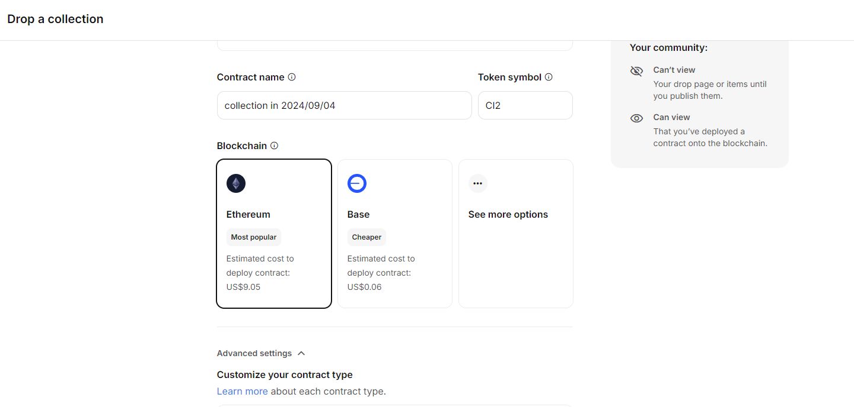
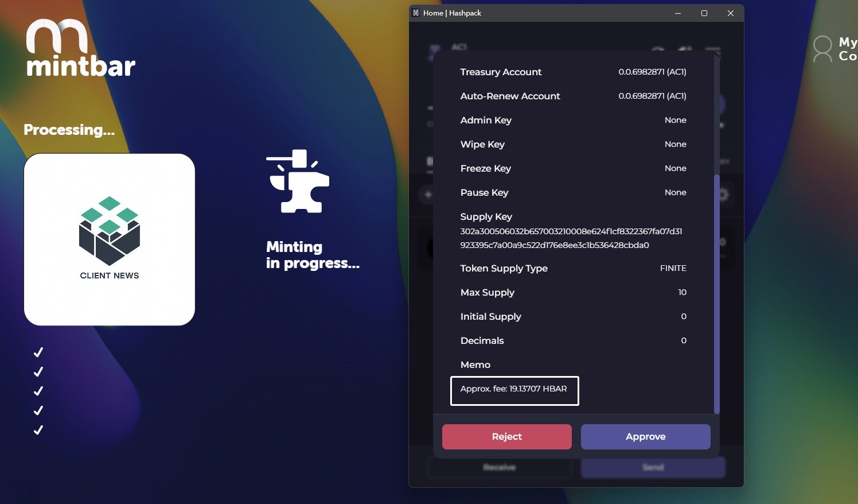
NFT Fees on Hedera
Create an NFT collection on MintBar standard Hedera contract
(19.1370HBAR ≈ 1.0005USD)
Create an NFT collection on OpenSea ERC-1155 Ethereum contract

Slide 7
Hedera NFT Market Brief Summary
Hedera NFT Activity (as of Aug 15, 2024)
NFTs Minted: 5,770,946
NFT Transfers: 5,837,419
Total Transaction Volume: $17,638,310
Native coin’s Market Cap (as of Aug 15, 2024)
HBAR: $1,925,404,750
Recent Transaction Volume (as of Aug 15, 2024)
30 Days Volume: $69,606.3
7 Days Volume: $6,376.8
Decrease of 71.5% from the previous week
Ethereum NFT Activity (as of Aug 15, 2024)
NFTs Minted: 14,598,959
NFT Transfers: 311365011
Total Transaction Volume: $33,884,423,678.1
Native coin’s Market Cap(as of Aug 15, 2024)
ETH: $303,712,530,657.00
Recent Transaction Volume (as of Aug 15, 2024)
30 Days Volume: $ 12,646,030.05
7 Days Volume: $ 2,565,689.37
Decrease of 11. 710792704681812% from the previous week
Reference: https://dappradar.com
Notes:
Hedera stands out for NFT applications and projects due to its low, fixed fees, immutable royalties, scalable transactions, and carbon-negative footprint. These features make it a unique and attractive option compared to traditional blockchain networks.
As of August 15, 2024, the Hedera network has seen significant activity:
5,770,946 NFTs minted
5,837,419 transfers
Total estimated transaction volume: $17,638,310
The estimated market capitalization of HBAR, Hedera's native currency, is approximately $1,868,593,439.
Over the past thirty days, the estimated transaction volume is $69,606.3. In the past week alone, the volume was $6,376.8, although this represents a 71.5% decrease from the previous week.

Slide 8
Field different
Filed name | Description
consensus timestamp | The consensus timestamp in seconds.nanoseconds
transaction hash | The hash value of the transaction processed on the Hedera network
valid start timestamp | The time the transaction is valid
charged tx fee | The transaction fee that was charged for that transaction
transaction id | The ID of the transaction
memo base64 | The memo attached to the transaction encoded in Base64 format
result | Whether the cryptocurrency transaction was successful or not
entity ID | The entity ID that is created from create transactions (AccountCreateTransaction, TopicCreateTransaction, TokenCreateTransaction, ScheduleCreateTransaction, ContractCreateTransaction, FileCreateTransaction).
name | The type of transaction
max fee | The maximum transaction fee the client is willing to pay
valid duration seconds | The seconds for which a submitted transaction is to be deemed valid beyond the start time. The transaction is invalid if consensusTimestamp is greater than transactionValidStart + valid_duration_seconds.
node | The ID of the node that submitted the transaction to the network
transfers | A list of the account IDs the crypto transfer occurred between and the amount that was transferred. A negative (-) sign indicates a debit to that account. The transfer list includes the transfers between the from account and to account, the transfer of the node fee, the transfer of the network fee, and the transfer of the service fee for that transaction. If the transaction was not processed, a network fee is still assessed.
token transfers | The token ID, account, and amount that was transferred to by this account in this transaction. This will not be listed if it did not occur in the transaction
assessed custom fees | The fees that were charged for a custom fee token transfer
links.next | A hyperlink to the next page of responses

Slide 9
Compare NFT on Hedera versus Ethereum
Ethereum has a larger market size, higher liquidity, and more participants, but Hedera offers unique advantages in terms of fees and scalability.

Slide 10
Compare NFT market on Ethereum and Hedera
NFT Liquidity Measures:
1. Number of Trades per trade: For any given token, how many addresses own this token
2. Average holding period: How does it take for a token to be sold
3. Trading Volume: Number of Tokens * Transaction Prices
Token Mint and Ownership Distribution
1. Relate Mints and Trades on Ethereum and Hedera
2. Ownership distribution of NFTs (NFT popularity/ Issuer Cash-out/ Risk of Project Collapse)
Notes:
Hedera stands out for NFT applications and projects due to its low, fixed fees, immutable royalties, scalable transactions, and carbon-negative footprint. These features make it a unique and attractive option compared to traditional blockchain networks.
As of August 15, 2024, the Hedera network has seen significant activity:
5,770,946 NFTs minted
5,837,419 transfers
Total estimated transaction volume: $17,638,310
The estimated market capitalization of HBAR, Hedera's native currency, is approximately $1,868,593,439.
Over the past thirty days, the estimated transaction volume is $69,606.3. In the past week alone, the volume was $6,376.8, although this represents a 71.5% decrease from the previous week.

Slide 11
Marketplaces Volume on the Hedera Network
Rank | Market | Avg Price ($) | Num of Traders | Sales | Volume ($)
1 | Zuse Market | 81.4 | 12.5k | 136.57k | 11.47M
2 | SentX | 63.77 | 12.33k | 80.6k | 5.18M
3 | Hash Axis | 29.44 | 2.51k | 23.82k | 641.98k
4 | NFTier | 7.1 | 8.85k | 57.94k | 340.44k
Top 4 Marketplaces by Transaction Volume on the Hedera
Rank | Market Name | Avg Price ($) | Num of Traders | Volume ($)
1 | OpenSea | 967.68 | 3.04M | 35.84B
2 | Blur | 1830 | 428.63k | 10.89B
3 | LooksRare | 8770 | 157.94k | 4.86B
4 | CryptoPunks | 111780 | 8.85k | 3.38B
5 | X2Y2 | 679.95 | 223.05k | 1.35B
6 | Rarible | 893.98 | 119.57k | 311.92M
7 | SuperRare | 13150 | 6.1k | 244.54M
8 | Magic Eden | 3550 | 34.24k | 238.32M
9 | Foundation | 2260 | 42.95k | 184.03M
10 | Decentraland | 2150 | 20.95k | 166.36M
Top 10 Marketplaces by Transaction Volume on Ethereum
Notes:
Through a comprehensive review of third-party data sources, we have identified that the primary marketplaces for Hedera NFTs are Zuse Market and SentX. These platforms have emerged as central hubs for NFT trading within the Hedera ecosystem.
Examining the nature of NFTs traded on these marketplaces, it is evident that the majority are digital collectibles. These are often valued for their uniqueness and digital scarcity rather than any intrinsic or tangible assets.
This observation aligns with a growing discourse in the academic community. Some scholars have raised concerns about the speculative nature of digital collectibles, arguing that without tangible assets to underpin their value, these NFTs may be more vulnerable to market volatility and speculative bubbles.
This issue is particularly pronounced in smaller blockchain markets like Hedera, where lower liquidity and fewer participants can exacerbate these risks. This can lead to greater price instability and higher risk exposure for users.
As the Hedera NFT market continues to evolve, these factors underscore the importance of cautious engagement and thorough due diligence for both collectors and investors.

Slide 12
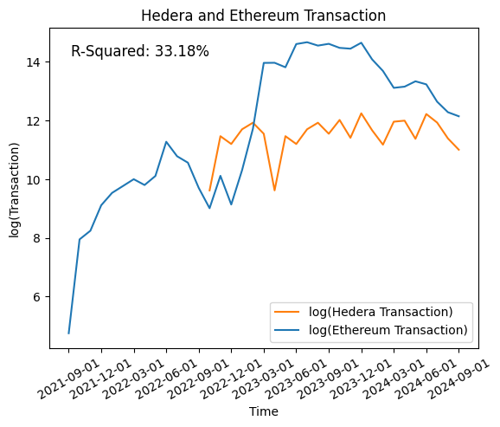
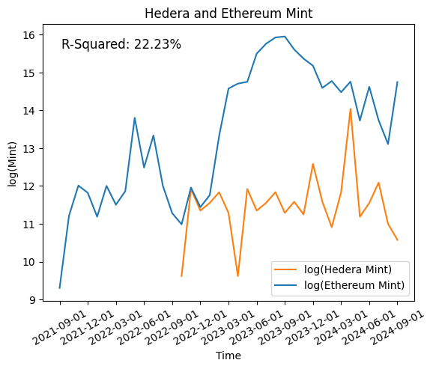
NFT Mint and Trades
Chain | Total Transactions | Total NFT Projects | Total NFTs（at least once traded）
Hedera | 4,083,715 | 25,811 | 4,737,976 / 2,409,103
Ethereum | 46,663,817 | 75,389 | 200,055,306 / 23,975,886
Transaction Statistics in Hedera and Ethereum
Hedera and Ethereum Mint/Transaction contrast
Notes:
When transferring an NFT from one account to another, the sending party receives a record of fungible tokens from the receiving party, which we define as a "transaction" record.
By analyzing Hedera's transaction data, we can gather statistics such as the total number of transactions, the total number of projects, the number of tokens traded at least once, and the number of NFTs held by addresses.
Comparing this with Ethereum, Hedera has around 4 million transactions, which is about 10% of Ethereum's total. In terms of projects, Hedera represents 33% of Ethereum's total. Of all NFTs minted on Hedera, 50% have been traded, compared to only 11% on Ethereum.

Slide 13
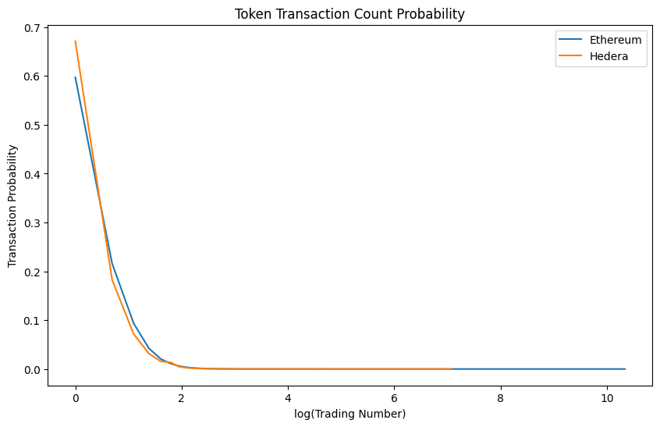
NFT Ownership and Trade Data
Chain | Average NFTs per Address | Top 10% Address NFT Share | Herfindahl-Hirschman Index
Hedera | 3.86 | 71.65% | 0.0011
Ethereum | 11.72 | 14.48% | 0.0004
NFTs Holding Statistics in Hedera and Ethereum
Chain | num=1 | num=2 | 3≤num≤10 | 10< num≤100 | 100< num
Hedera | 67.1141% | 18.2404% | 14.2389% | 0.4038% | 0.0028%
Ethereum | 59.7041% | 21.5892% | 18.0776% | 0.6110% | 0.0180%
NFTs Transaction Count Probability in Hedera and Ethereum
Hedera and Ethereum Single Token Transaction Count Probability
Notes:
For addresses holding NFTs, the average number per address on Hedera is 3.86, while on Ethereum it's 11.72. The top 10% of addresses on Hedera hold 14.48% of total NFTs, whereas on Ethereum, it's 71.65%.
The Herfindahl-Hirschman Index (HHI) shows Hedera at 0.0004 and Ethereum at 0.0011, indicating high decentralization. However, multiple addresses might belong to the same entity, which could affect the validity of these indices.

Slide 14
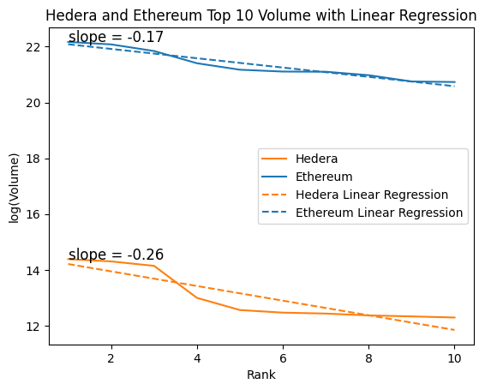
Top NFT Projects by Transaction Volume on Hedera
Rank | Project | Avg. Price | Volume | Traders | Sales
1 | Dead Pixels Ghost Club | $406.57 | $1.77M | 1.98k | 4.48k
2 | Earthlings.land | $305.18 | $1.63M | 3.92k | 15.28k
3 | HANGRY BARBOONS | $249.66 | $1.39M | 1.81k | 5.85k
4 | HGraph Punks | $193.44 | $441.12k | 1.06k | 1.86k
5 | Golden Banana Coin | $467.11 | $285.34k | 504 | 516
6 | Dead Pixels Ghost Pass | $578.52 | $259.93k | 453 | 455
7 | Warsome Wizards | $88.51 | $251.35k | 506 | 2.3k
8 | Creamies Collection | $254.34 | $235.29k | 468 | 985
9 | HashPack Special Collection | $23.30 | $227.1k | 5.86k | 14.43k
10 | Koala Klub Gen 1 | $186.02 | $218.15k | 624 | 1.02k
Top 10 NFT Projects by Transaction Volume on the Hedera
Rank | Collection Name | Avg. Price | Volume | Traders | Sales
1 | Bored Ape Yacht Club | $108.23k | $4.25B | 19.99k | 58.87k
2 | CryptoPunks | $109.34k | $3.89B | 9.33k | 30.32k
3 | Mutant Ape Yacht Club | $19.84k | $3.07B | 42.56k | 147.41k
4 | Azuki | $22.38k | $1.98B | 23.8k | 97.56k
5 | Meebits | $22.74k | $1.57B | 18.87k | 51.12k
6 | Art Blocks | $3.89k | $1.47B | 62.86k | 273.79k
7 | Otherdeed for Otherside | $4.51k | $1.46B | 59.3k | 217.45k
8 | Terraform by Mathcastles | $27.03k | $1.29B | 8.08k | 35.48k
9 | CLONE X - X TAKASHI MURAKAMI | $12.79k | $1.03B | 26.43k | 80.66k
10 | Pudgy Penguins | $10.85k | $1.01B | 23.28k | 94.68k
Top 10 NFT Projects by Transaction Volume on Ethereum
Notes:
By using data from DappRadar.com, we can analyze the performance of Hedera's top 10 NFT collections. This includes metrics such as price, market capitalization, transaction volume, and participant count.
The data reveals that Hedera's NFT market is smaller compared to mainstream markets like Ethereum and Solana. It has fewer participants and lower liquidity.
Figure illustrates that the trading volume trends of the top 10 projects on both Hedera and Ethereum are somewhat similar as the project size ranking changes. Specifically, the linear regression slope is -0.17 for Ethereum and -0.26 for Hedera.

Slide 15
NFT Average Holding Period on the Hedera Network
Project | Mean Gap Time | Median Gap Time | Standard Deviation of Transfer Time | Minimum Transfer Time | Maximum Transfer Time | 25% Quantile | 50% Quantile | 75% Quantile | Total Transfer num
Dead Pixels Ghost Pass | 63.92 | 9.46 | 114.13 | <0.01 | 788.60 | 0.35 | 9.46 | 77.71 | 63.92
Koala Klub | 24.74 | 1.92 | 64.72 | <0.01 | 692.10 | 0.03 | 1.92 | 20.69 | 669
Warsome Wizards | 47.20 | 1.69 | 95.63 | <0.01 | 759.62 | 0.03 | 1.69 | 32.82 | 26067
Golden Banana Coin | 77.21 | 15.46 | 129.83 | <0.01 | 721.56 | 1.27 | 15.46 | 83.94 | 1703
HANGRY BARBOONS | 70.73 | 7.78 | 119.36 | <0.01 | 681.13 | 0.65 | 7.78 | 87.43 | 15879
Hotdog Hustle | 59.37 | 0.46 | 113.03 | <0.01 | 567.43 | 0.00 | 0.46 | 44.13 | 333
HGraph Punks | 31.37 | 2.60 | 83.23 | <0.01 | 959.32 | 0.39 | 2.60 | 28.18 | 3247
Dead Pixels Ghost Club | 49.05 | 3.04 | 105.23 | <0.01 | 802.06 | 0.04 | 3.04 | 39.89 | 17019
HashPack Special Collection | 68.14 | 28.84 | 92.52 | <0.01 | 491.98 | 0.58 | 28.84 | 104.18 | 37284
NFT Projects by Average Holding Period on the Hedera
Notes:
We analyzed several popular projects using Consensus Timestamp data from Hedera's NFT transactions. We excluded transfers with a zero interval, considering the first transfer after minting as the start of the holding period. Our calculations include the average, median, standard deviation, minimum, maximum, and quantiles of holding periods in days for tokens from the top ten NFT projects across different accounts.

Slide 16
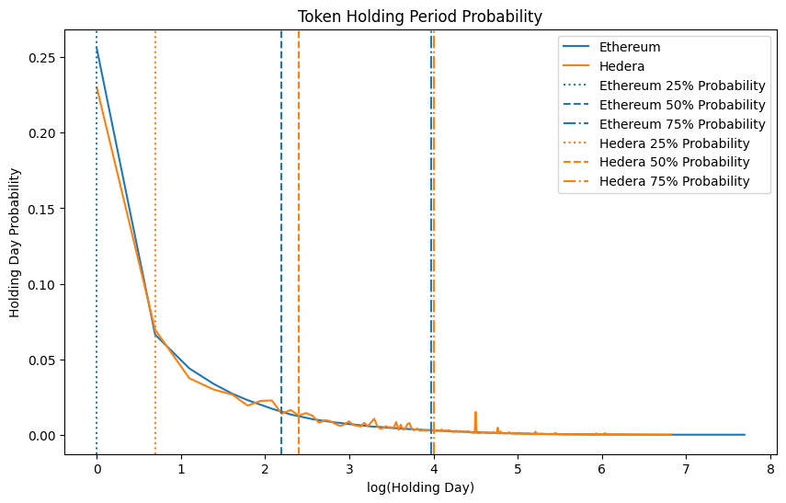
NFT Average Holding Period on the Ethereum Network
Collection Name | Mean Gap Time | Median Gap Time | Standard Deviation of Gap Time | Minimum Gap Time | Maximum Gap Time | 25% Quantile | 50% Quantile | 75% Quantile | Total Transfer Num
Pudgy Penguins | 57.46 | 2.87 | 144.94 | <0.01 | 1122.46 | 0.28 | 2.87 | 25.37 | 72260
Mutant Ape Yacht Club | 42.62 | 0.95 | 119.81 | <0.01 | 1098.73 | 0.13 | 0.95 | 16.40 | 119646
Azuki | 40.67 | 1.29 | 111.38 | <0.01 | 953.39 | 0.15 | 1.29 | 15.54 | 78528
Doodles | 49.71 | 1.55 | 127.81 | <0.01 | 1049.43 | 0.19 | 1.55 | 26.51 | 57666
Bored Ape Yacht Club | 80.41 | 5.02 | 186.25 | <0.01 | 1215.59 | 0.40 | 5.02 | 49.50 | 45512
CloneX | 42.13 | 0.92 | 116.08 | <0.01 | 990.45 | 0.14 | 0.92 | 16.89 | 68163
The Otherside | 31.71 | 0.61 | 90.04 | <0.01 | 857.65 | 0.13 | 0.61 | 8.54 | 150170
Beanz | 30.61 | 1.32 | 83.04 | <0.01 | 882.50 | 0.16 | 1.32 | 14.69 | 119710
NFT Projects by Average Holding Period on Ethereum
Notes:
It's important to note that due to non-standard function transfers in the data, these figures are approximate estimates. Most popular projects on Hedera see their first transfer within a month of minting, with transfer frequency decreasing over three to six months. In contrast, Ethereum projects often see transaction frequencies extending over a year.
We also analyzed transaction data from both Hedera and Ethereum to determine the Token Holding Period Probability as of September 2024. Figure shows that Hedera has a higher probability of longer holding periods compared to Ethereum.

Slide 17
NFT Token Concentration on the Hedera Network
Collection Name | History Holders Num | Current Holders Num | Max holding Num | Top 10 holding Sum | Total Mint
Creamies | 626 | 96 | 593 | 1001 | 1111
Dead Pixels Ghost Pass | 769 | 319 | 293 | 402 | 799
Koala Klub | 189 | 66 | 22 | 63 | 100
Warsome Wizards | 773 | 398 | 623 | 2002 | 4413
Golden Banana Coin | 901 | 265 | 26 | 168 | 444
HANGRY BARBOONS | 3089 | 884 | 285 | 1257 | 4444
Hotdog Hustle | 125 | 80 | 13 | 90 | 199
HGraph Punks | 714 | 310 | 30 | 134 | 512
Dead Pixels Ghost Club | 2971 | 1129 | 549 | 1099 | 3900
HashPack Special Collection | 25029 | 16873 | 1006 | 5782 | 29935
NFT Projects by Token Concentration on the Hedera
Collection Name | History Holders Num | Current Holders Num | Max holding Num | Top 10 holding Sum | Total Mint
Pudgy Penguins | 27961 | 5190 | 183 | 859 | 8888
Mutant Ape Yacht Club | 65801 | 11601 | 389 | 1988 | 19497
Azuki | 30761 | 4154 | 346 | 1544 | 10000
Doodles | 31358 | 4201 | 2874 | 3598 | 10000
Bored Ape Yacht Club | 35282 | 5414 | 281 | 1383 | 10000
CloneX | 37429 | 9505 | 534 | 1639 | 19602
The Otherside | 101588 | 15008 | 54577 | 70709 | 100000
Beanz | 39363 | 7668 | 678 | 2722 | 19950
NFT Projects by Token Concentration on Ethereum
Notes:
The Whale Concentration Index (WCI) and Unique Holder Ratio are crucial metrics for understanding the distribution of an NFT project. These metrics are strongly negatively correlated and are especially important for evaluating limited edition collections.
We selected several popular projects and used the current month as the cutoff date to compile data on the total number of accounts that have historically held the tokens, the total number of current holders, the maximum number of tokens held by a single account, and the number of tokens held by the top ten accounts.
Comparing the data from both Hedera and Ethereum, we see that most popular NFTs on the Hedera chain have lower participation levels than those on Ethereum. However, the active user engagement for certain projects on Hedera is comparable to prominent Ethereum projects, and there is a notable similarity in their whale concentration metrics.

Slide 18
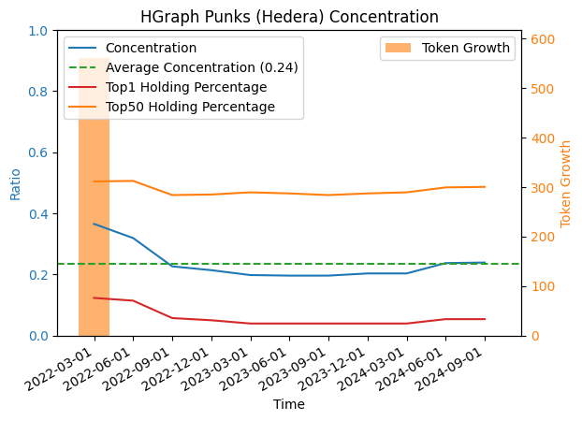
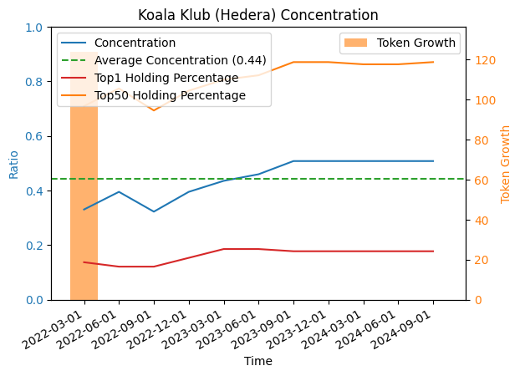
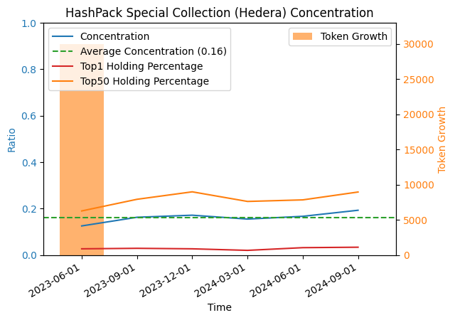
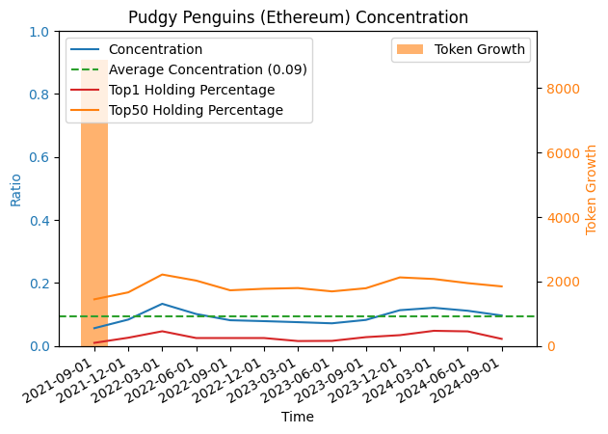
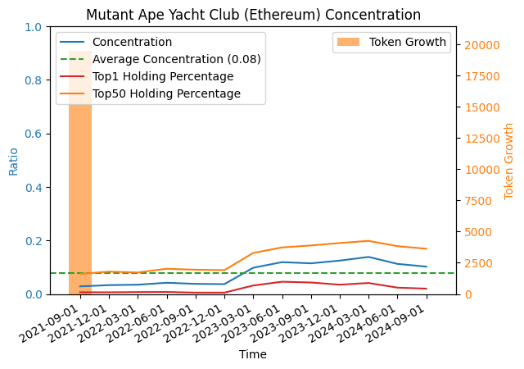
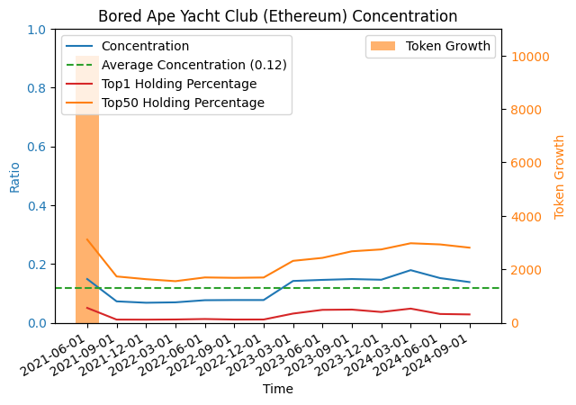
NFT Token Concentration on the Hedera Network
Hedera and Ethereum's three longest running Top projects
Notes:
We also compared the three oldest projects from the selected popular projects on both chains. As shown in Figure, Hedera exhibits a higher concentration compared to Ethereum. However, it's important to note that the total number of mints for popular projects on Hedera is lower than that of popular projects on Ethereum, which may influence the concentration results.

Slide 19
Royalty Fees For Hedera NFT
Hedera Network natively supports NFT royalty fees, which are crucial for incentivizing creators and boosting market activity.

Slide 20
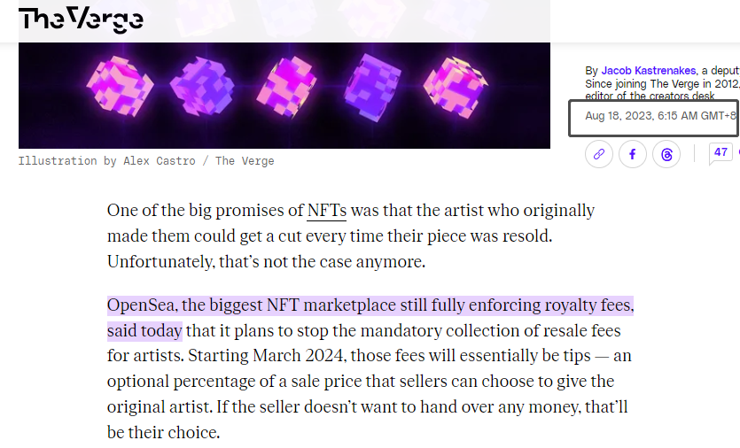
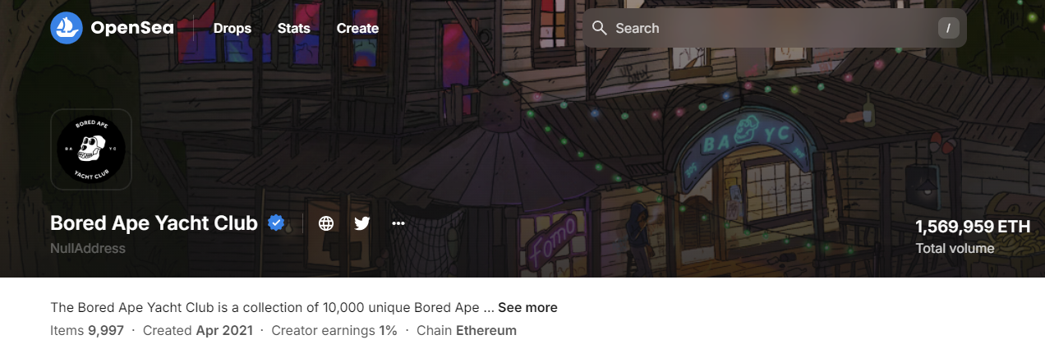
Royalty Fee For Hedera NFT
Natively supports NFT royalty fees
Essential for incentivizing creators and boosting market activity.
Compatible with Ethereum Virtual Machine (EVM).

Slide 21
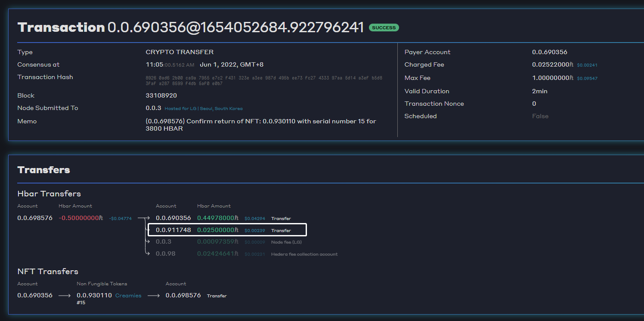
Royalty Fee For Hedera NFT
Why supports NFT royalty fees natively
Essential for incentivizing creators and boosting market activity.
Compatible with Ethereum Virtual Machine (EVM).
Notes:
Hedera’s Native Support for Royalty Fees
Hedera Hashgraph stands out in this regard because it natively supports NFT royalty fees. This means that royalty payments are automatically enforced by the network’s smart contract capabilities, which are compatible with the Ethereum Virtual Machine (EVM). This compatibility ensures that developers can easily integrate and deploy their NFT projects on Hedera, leveraging the benefits of built-in royalty enforcement.
Hedera’s Commitment to Creators
In contrast, Hedera’s native support for royalty fees demonstrates a strong commitment to protecting creators' rights and ensuring they are fairly compensated for their work. By embedding royalty enforcement directly into the blockchain protocol, Hedera provides a reliable and transparent way for creators to earn ongoing revenue from their NFTs, regardless of where or how many times they are resold.

Slide 22
Royalty Fee and NFT Liquidity
Pros and Cons of Royalty Fee:
1. Creator can persistently generate income flow from the NFT trading
2. Incentivize more investment in community building (providing more utility for NFT holders)
3. However, it can also be viewed as “tax”
4. Unclear whether royalty fees will affect NFT trading and investments.

Slide 23
HKU Team for Blockchain Business Applications
1. AI + NFT --- Application to AI Design
2. Hedera API Usage
3. HKU-NFT Project --- Customized Data Services
4. Education Material of NFT

Slide 24
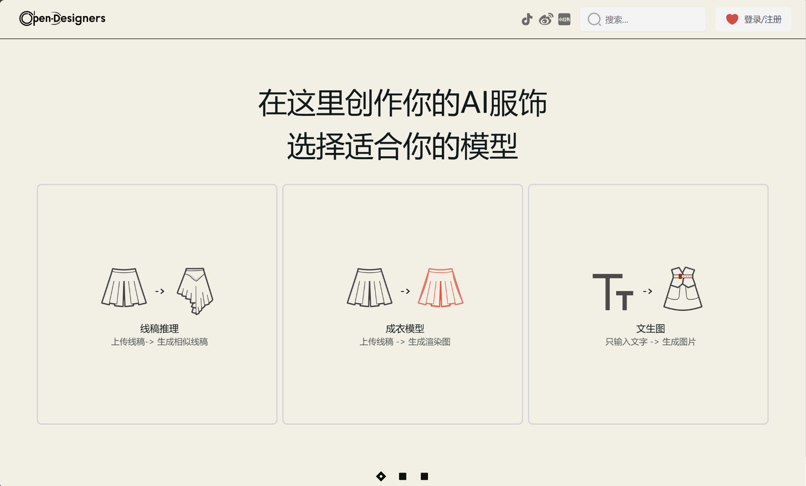
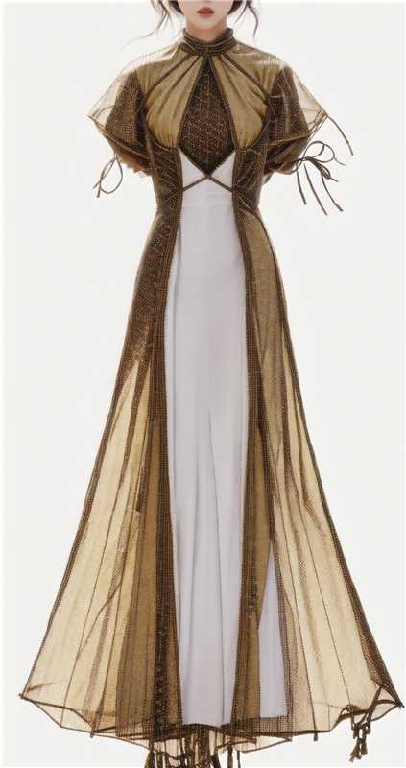


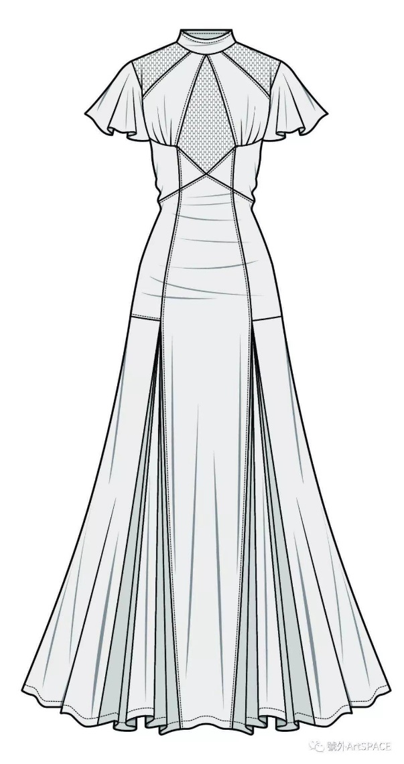

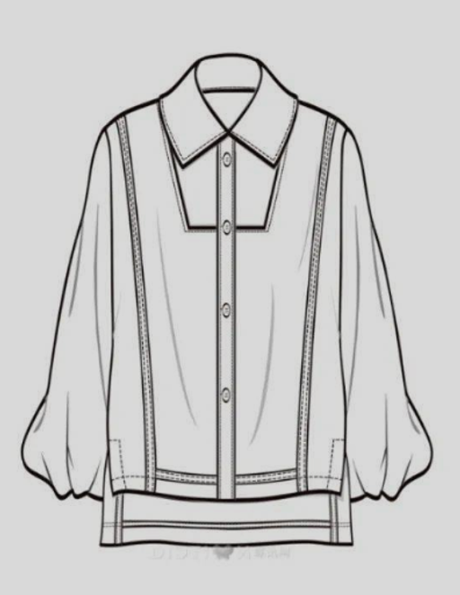
Copyright on the AI Design and Blockchain
The combination of AI and blockchain offers more imaginative possibilities
Creators have the potential for more flexible copyright control.
Notes:
Imaginative Possibilities with AI and Blockchain
Flexible Copyright Control for Creators
The convergence of AI and blockchain opens up an unprecedented realm of imaginative possibilities. AI has already revolutionized creative content generation, from art and music to fashion design, while blockchain ensures secure and transparent ownership and transaction management. Together, these technologies create a powerful synergy that redefines copyright and ownership in the digital age. Creators gain more flexible and robust control over their intellectual property, with blockchain enabling smart contracts to automate rights management and royalty payments. Notably, Hedera's native royalty system significantly enhances on-chain copyright protection, ensuring creators are fairly compensated whenever their work is used or sold.
Case Study: AI Designer Fashion Platform
Let me illustrate this with an example from our team’s project. We have developed an AI-powered fashion design generation platform. On this platform, creators can design unique clothing items using AI tools. Once a creator generates a design, they can tokenize it on the blockchain, transforming it into a digital asset with verifiable ownership.
This tokenization process opens up a multitude of opportunities. The digital tokens can be traded on blockchain marketplaces, allowing designers to reach a global audience. Moreover, it creates a seamless integration across the entire fashion industry value chain, connecting consumers, designers, AI service platforms, and clothing manufacturers.

Slide 25
Copyright on the AI Design and Blockchain
The combination of AI and blockchain offers more imaginative possibilities
Creators have the potential for more flexible copyright control.
Unlocking Industry Pathways
Designer
Fashion Sketches
Sample
Clothes
Model
Display
Pre-Sale
Consumer
Traditional Fashion Design Sales Process
Notes:
Unlocking Industry Pathways
By leveraging blockchain, we can streamline the entire process from design to production. Traditionally, the fashion design and sales process involves multiple steps: designers create fashion sketches, which are then turned into sample clothes, displayed by models, and finally pre-sold to consumers. This sequence can take anywhere from several days to weeks. However, with the integration of AI-generated fashion designs and blockchain technology, the process can be significantly accelerated and simplified.
For instance, the new workflow can be transformed into Designers -> AI Platform -> Blockchain Token/Product Factory -> Consumer. A consumer who buys a tokenized design can directly place an order with a manufacturing partner to produce the physical garment. This not only enhances efficiency but also ensures that the designer is credited and compensated for their work at every stage.
This integration can also foster new business models. Designers can license their tokenized designs to multiple manufacturers, earning royalties each time a garment is produced and sold. This democratizes access to high-quality designs and empowers creators to maximize the value of their intellectual property.
Invitation to Explore Open-Designers
Regarding our Open-Designers AI fashion generation platform, we warmly welcome anyone interested to learn more and explore its capabilities. This platform not only leverages advanced AI to generate unique fashion designs but also integrates seamlessly with blockchain technology. By tokenizing designs, we ensure verifiable ownership and enable secure, transparent transactions. We believe this powerful combination can be a valuable tool for creators looking to innovate, protect their intellectual property, and expand their reach in the fashion industry.

Slide 26
Copyright on the AI Design and Blockchain
The combination of AI and blockchain offers more imaginative possibilities
Creators have the potential for more flexible copyright control.
Unlocking Industry Pathways
Blockchain
Token
Designer
AI platform
Consumer
Product
Factory
AI + Blockchain Fashion Design Sales Process
Notes:
Unlocking Industry Pathways
By leveraging blockchain, we can streamline the entire process from design to production. Traditionally, the fashion design and sales process involves multiple steps: designers create fashion sketches, which are then turned into sample clothes, displayed by models, and finally pre-sold to consumers. This sequence can take anywhere from several days to weeks. However, with the integration of AI-generated fashion designs and blockchain technology, the process can be significantly accelerated and simplified.
For instance, the new workflow can be transformed into Designers -> AI Platform -> Blockchain Token/Product Factory -> Consumer. A consumer who buys a tokenized design can directly place an order with a manufacturing partner to produce the physical garment. This not only enhances efficiency but also ensures that the designer is credited and compensated for their work at every stage.
This integration can also foster new business models. Designers can license their tokenized designs to multiple manufacturers, earning royalties each time a garment is produced and sold. This democratizes access to high-quality designs and empowers creators to maximize the value of their intellectual property.
Invitation to Explore Open-Designers
Regarding our Open-Designers AI fashion generation platform, we warmly welcome anyone interested to learn more and explore its capabilities. This platform not only leverages advanced AI to generate unique fashion designs but also integrates seamlessly with blockchain technology. By tokenizing designs, we ensure verifiable ownership and enable secure, transparent transactions. We believe this powerful combination can be a valuable tool for creators looking to innovate, protect their intellectual property, and expand their reach in the fashion industry.

Slide 27
Real-World Asset (RWA) Tokenization
Benefits of RWA Tokenization
Increased Liquidity
Fractional Ownership
Transparency and Security
Reduced Transaction Costs
Global Market Access
Asset
Token
How RWA Tokenization Works
Asset Identification
Valuation and Legal Compliance
Token Issuance
Market Placement
Trading
Transaction
Notes:
Based on the AI fashion design we just mentioned, an important point to highlight is Real-World Asset (RWA) Tokenization. RWA offers many benefits.
Benefits of RWA Tokenization
Increased Liquidity: One of the primary advantages is the increased liquidity. Traditionally, assets like real estate or art have been difficult to buy and sell quickly. Tokenization allows these assets to be traded more easily on blockchain marketplaces, making it simpler for investors to enter and exit positions.
Fractional Ownership: Another significant benefit is fractional ownership. High-value assets, such as a multimillion-dollar property, can be divided into smaller, more affordable units. This means that more investors can participate in owning a fraction of these valuable assets, democratizing access to investment opportunities.
Transparency and Security: Blockchain technology provides a transparent and immutable ledger. All transactions are recorded on the blockchain, ensuring that they are secure and can be verified by anyone. This level of transparency reduces the risk of fraud and increases trust among investors.
Reduced Transaction Costs: By automating processes through smart contracts, tokenization reduces the need for intermediaries. This not only speeds up transactions but also lowers the associated costs, making investments more efficient and cost-effective.
Global Market Access: Finally, tokenization enables global market access. Investors from around the world can participate in buying and selling tokens, breaking down geographical barriers and opening up new investment opportunities on a global scale.“
How It Works
"Now, let's take a look at how the process of RWA tokenization works.
Asset Identification: The first step is asset identification. This involves selecting a physical asset that you want to tokenize. It could be real estate, art, precious metals, or any other valuable physical asset.
Valuation and Legal Compliance: Next, it's crucial to ensure accurate valuation and regulatory compliance. This step involves assessing the value of the asset and making sure that all legal requirements are met to tokenize it.
Token Issuance: Once the asset is valued and compliant with regulations, digital tokens representing the asset are created. These tokens are essentially digital representations of the asset's ownership.
Market Placement: After issuing the tokens, they are listed on a blockchain marketplace. This is where investors can discover and purchase the tokens.
Trading: Finally, investors can buy, sell, and trade these tokens on the blockchain marketplace. This trading activity increases the liquidity of the asset and allows for easier and more efficient transactions.
By following these steps, we can transform traditional physical assets into digital tokens, unlocking a range of benefits and new opportunities for investors."

Slide 28
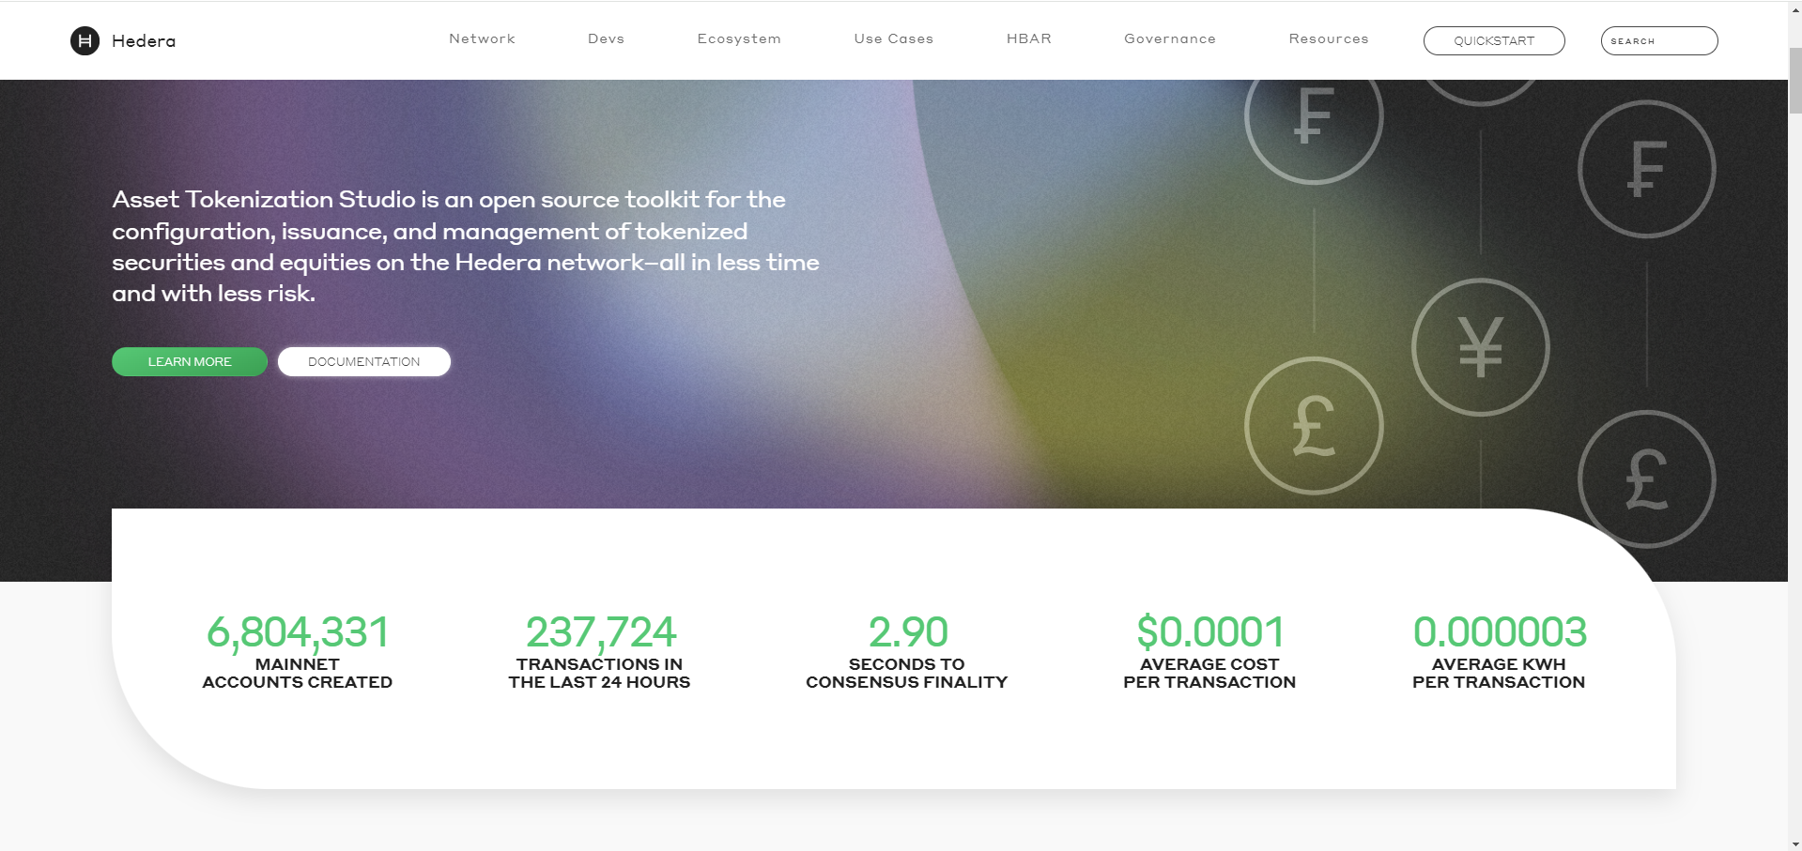
HEDERA DATA API

Slide 29
Content
Api Usage
How to collect data information
Data structure comparison
Result overview

Slide 30
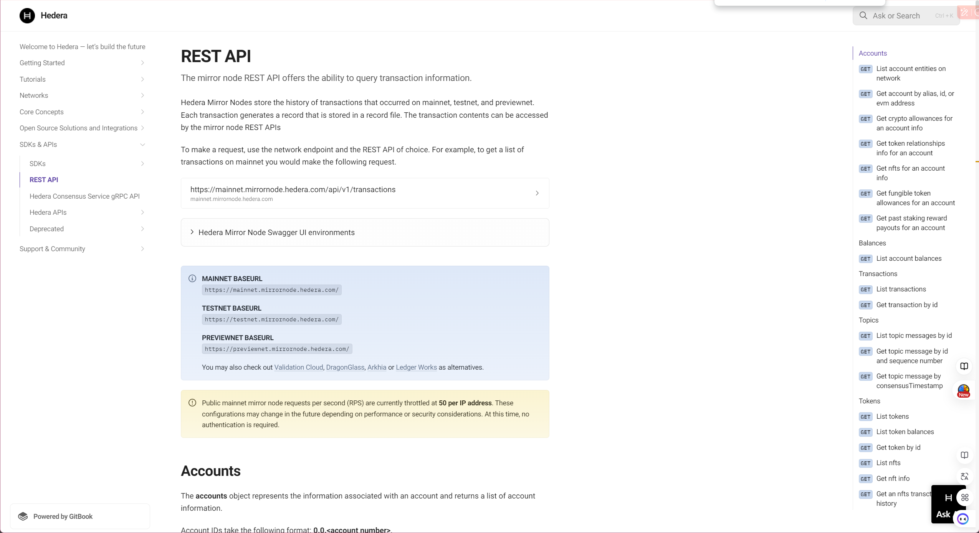
Hedera official document
Notes:
Hedera Mirror Nodes store the history of transactions that occurred on mainnet, testnet, and previewnet. Each transaction generates a record that is stored in a record file. The transaction contents can be accessed by the mirror node REST APIs. (https://docs.hedera.com/hedera/sdks-and-apis/rest-api)

Slide 31
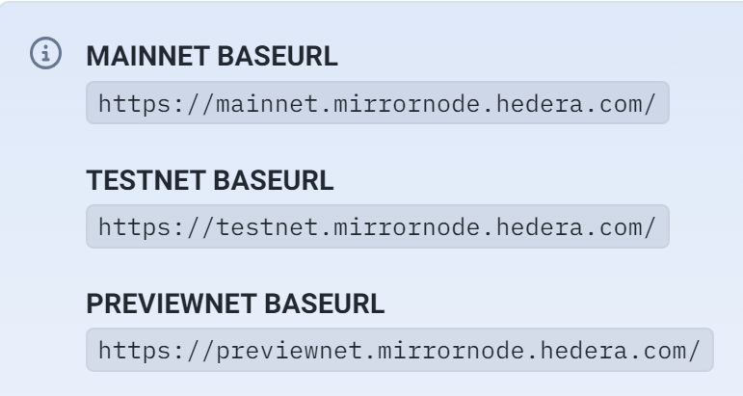
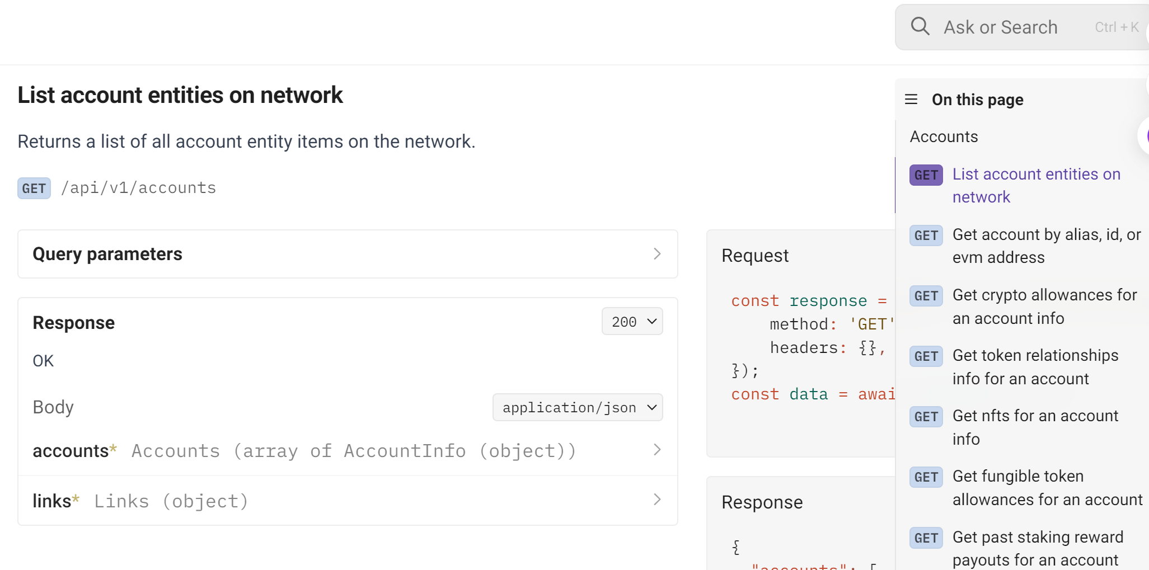
REST API USAGE
To make a request, use the network endpoint and the REST API of choice. For example, to get a list of account entity on mainnet you would make the following request
1. base url
2. Sub url
Notes:
Base_url + suburl = what you want ，find the mainnet node as the base url ,and joint the sub url want you want

Slide 32
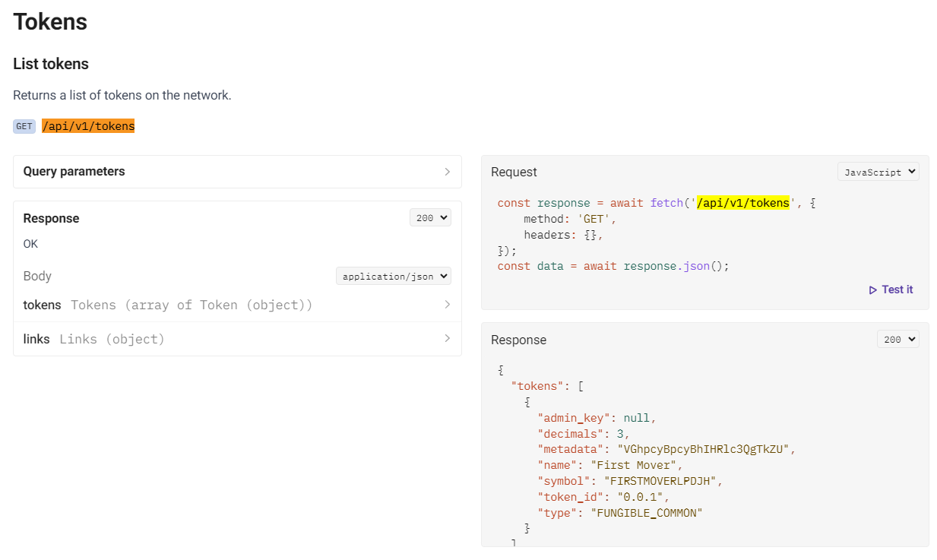
Data Acquisition Solution
/api/v1/tokens
Notes:
Get 29,011 contracts in hedera block chain, 25,811 traded

Slide 33
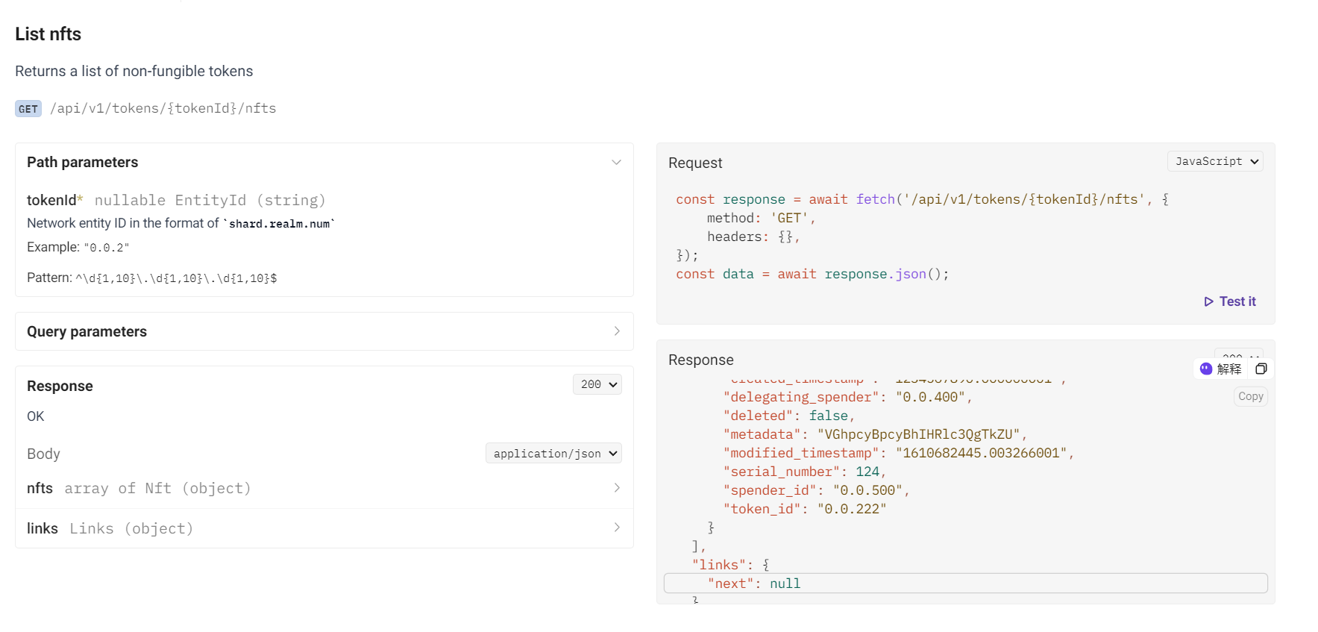
Data Acquisition Solution
/api/v1/tokens/{tokenId}/nfts
Notes:
Use token id of each contracts to get each series number of each token id, （series num 唯一编码）跟以太坊不一样，数据层面上抽象描述

Slide 34
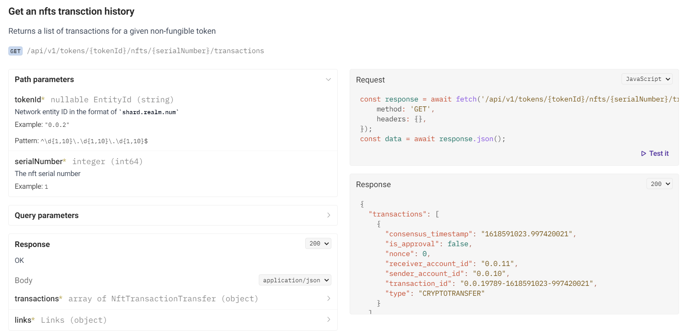
Data Acquisition Solution
/api/v1/tokens/{tokenId}/nfts/{serialNumber}/transactions
Notes:
Iterate over all the token and series number of each contract above to get the transactions (mint ,deleted , cryptos transfer,cryptos trades ) for each contract
Total 9 M + transactions records in hedera up to 2024/ 8/26

Slide 35
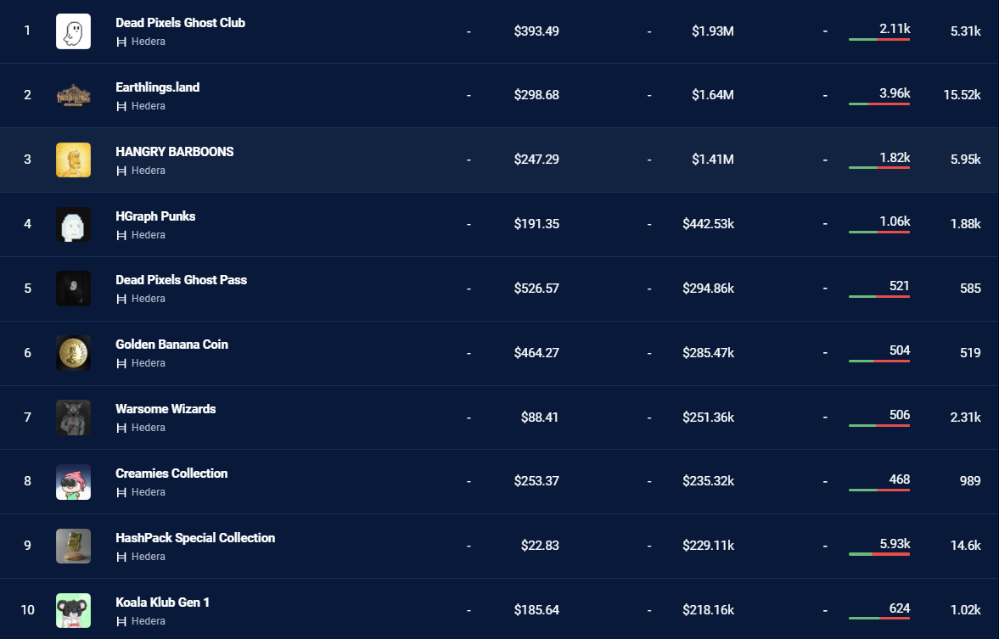
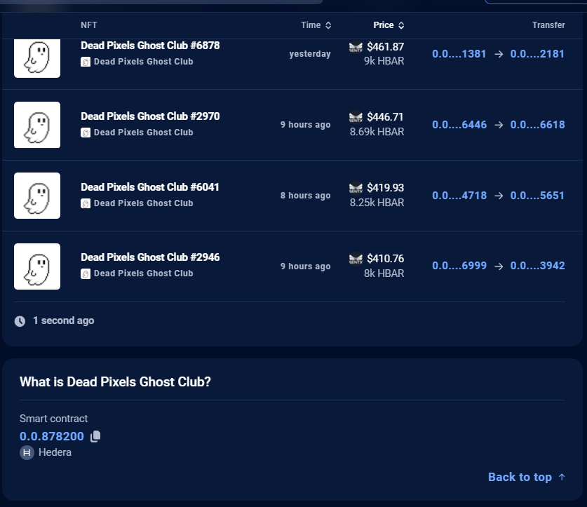
Top ten contracts order by volume
source:dappradar.com
Notes:
According the ten ranking panel ,

Slide 36
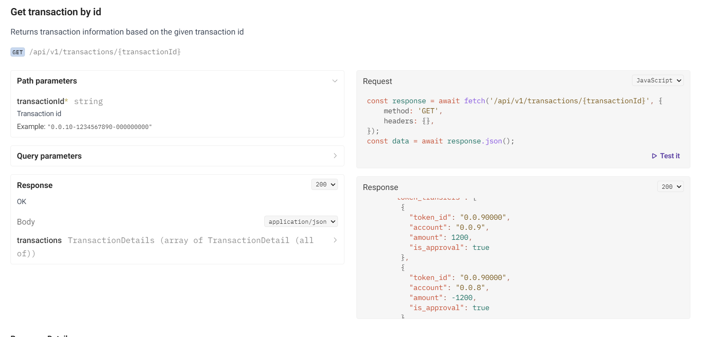
Data Acquisition Solution
/api/v1/transactions/{transactionId}
Notes:
Use the transaction hash to get sender and receiver details accounts detail in the transaction ，Get the Top 10 volumes contracts detail and to calculate the concentration index ,comparison data and so on, get 516928 result rows

Slide 37
Hedera Achievements
Get 29,011 contracts , and 25,000+ traded
Get 9M+ transaction records
Get top 10 NFT transaction 516,928 detail rows
Data comparison : Ethereum vs Hedera
Notes:
Achievements，https://github.com/xujiahuayz/hedera-staking.git

Slide 38
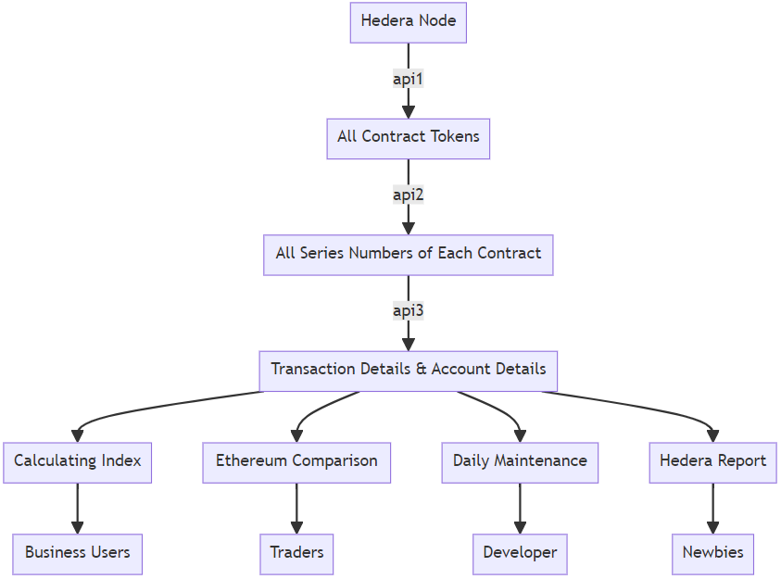
Data Acquisition Solution
The whole process of data collection Flow chart
Notes:
Flow chart

Slide 39
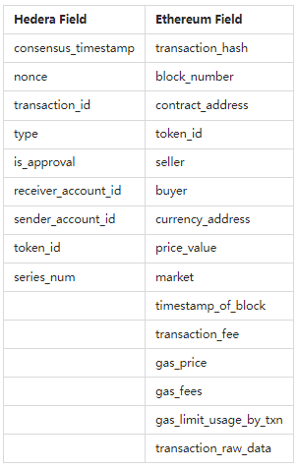
Field difference
comparison table
Notes:
In summary, Hedera and Ethereum focus on different aspects in their fields, reflecting their distinct design philosophies regarding transaction processing, fee structures, and account management.

Slide 40
Importance of blockchain
Why？
1. Decentralization and Trust
2. Transparency and Traceability
3. Cryptographic Security and Privacy Features
4. Efficiency and Cost Reduction
5. Innovation and New Business Models
Notes:
数据对投资和监管都很重要，数据

Slide 41
HKU-NFT
All-in-one NFT Data Analysis Platform
Comprehensive Data Insights
Customized Data Dashboard
Outstanding Academic Contributions
Top Academic & Development Team

Slide 42

All-in-one NFT Data Analysis Platform
On-Chain Data
HKU NFT Data Analysis Platform
Developers
HKU-NFT
API
OpenSea
Raw Data
Filtered Data
Key Metrics
Blur
HKU-NFT
Dashboard
Analysts
X2Y2
Web3
Node
Logs
Topic
Token_id
Transfer
Address
Volume
Market Cap
Strike Price
Transactions
Active Wallets
Minting
...
LooksRare
Cleaned
Augmented
HKU-NFT
Weekly Report
Traders
Zora
HKU-NFT
Lecture
Newbies

Slide 43
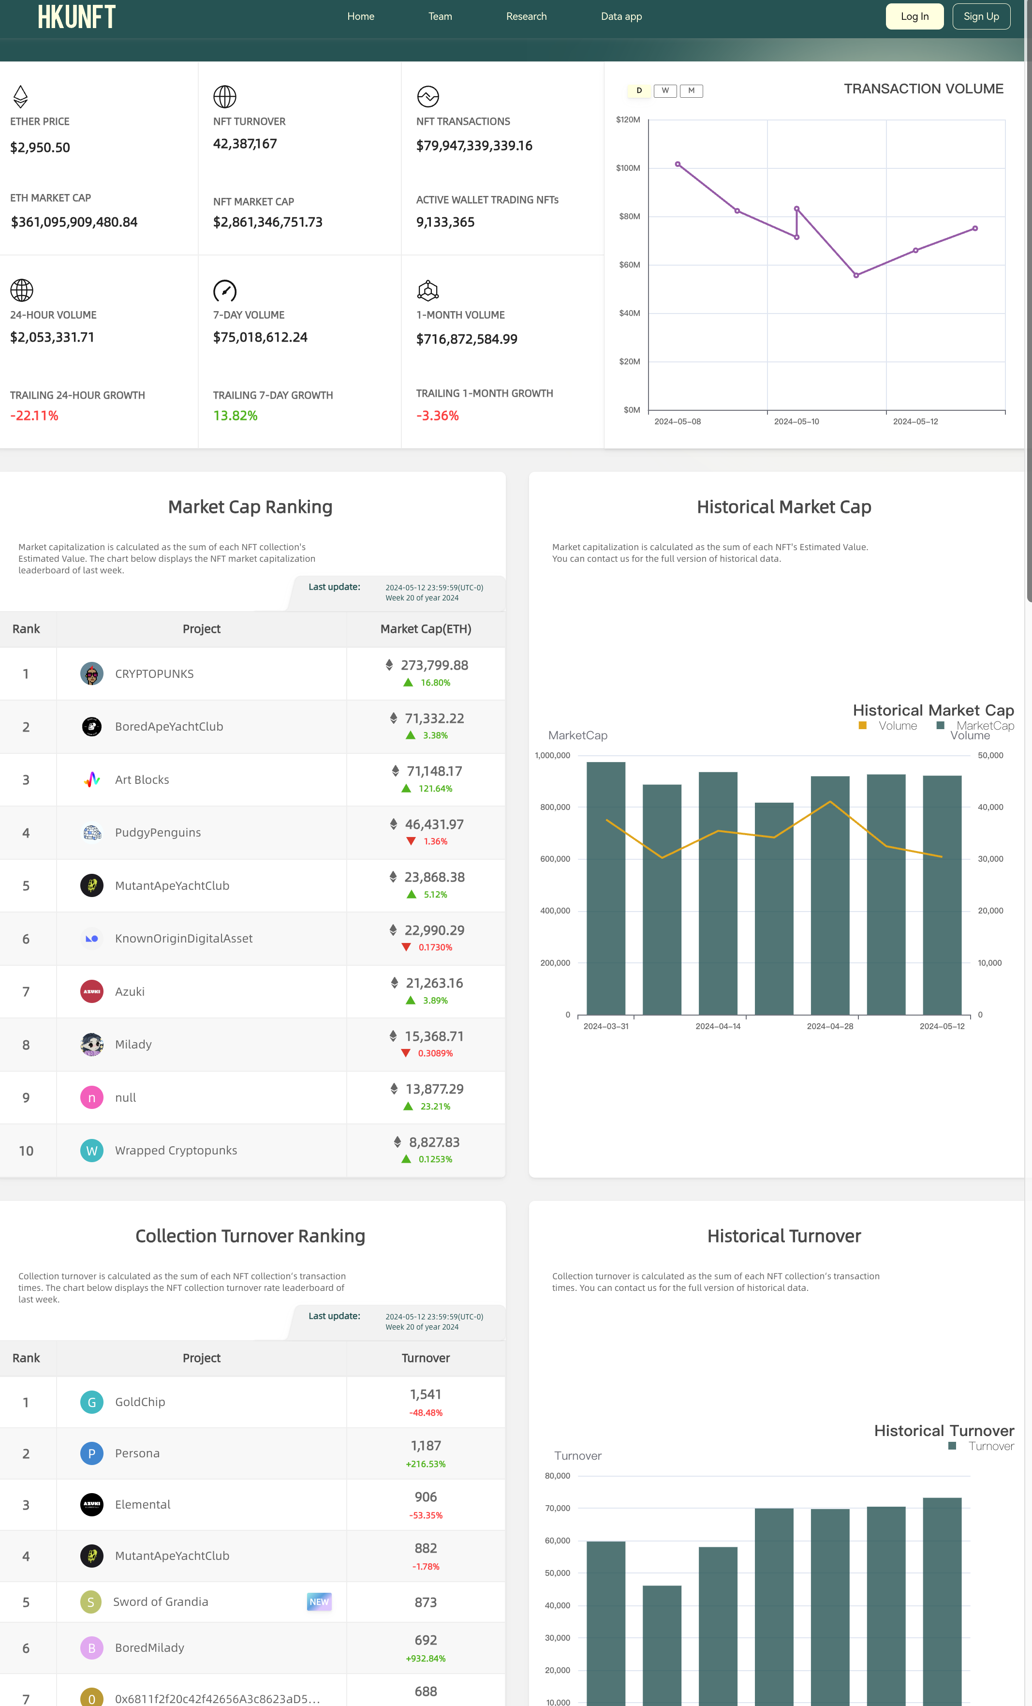
Customized Data Interface
NFT Data Dashboard
All-in-One View
Rankings & Trends
In-Depth Analytics

Slide 44
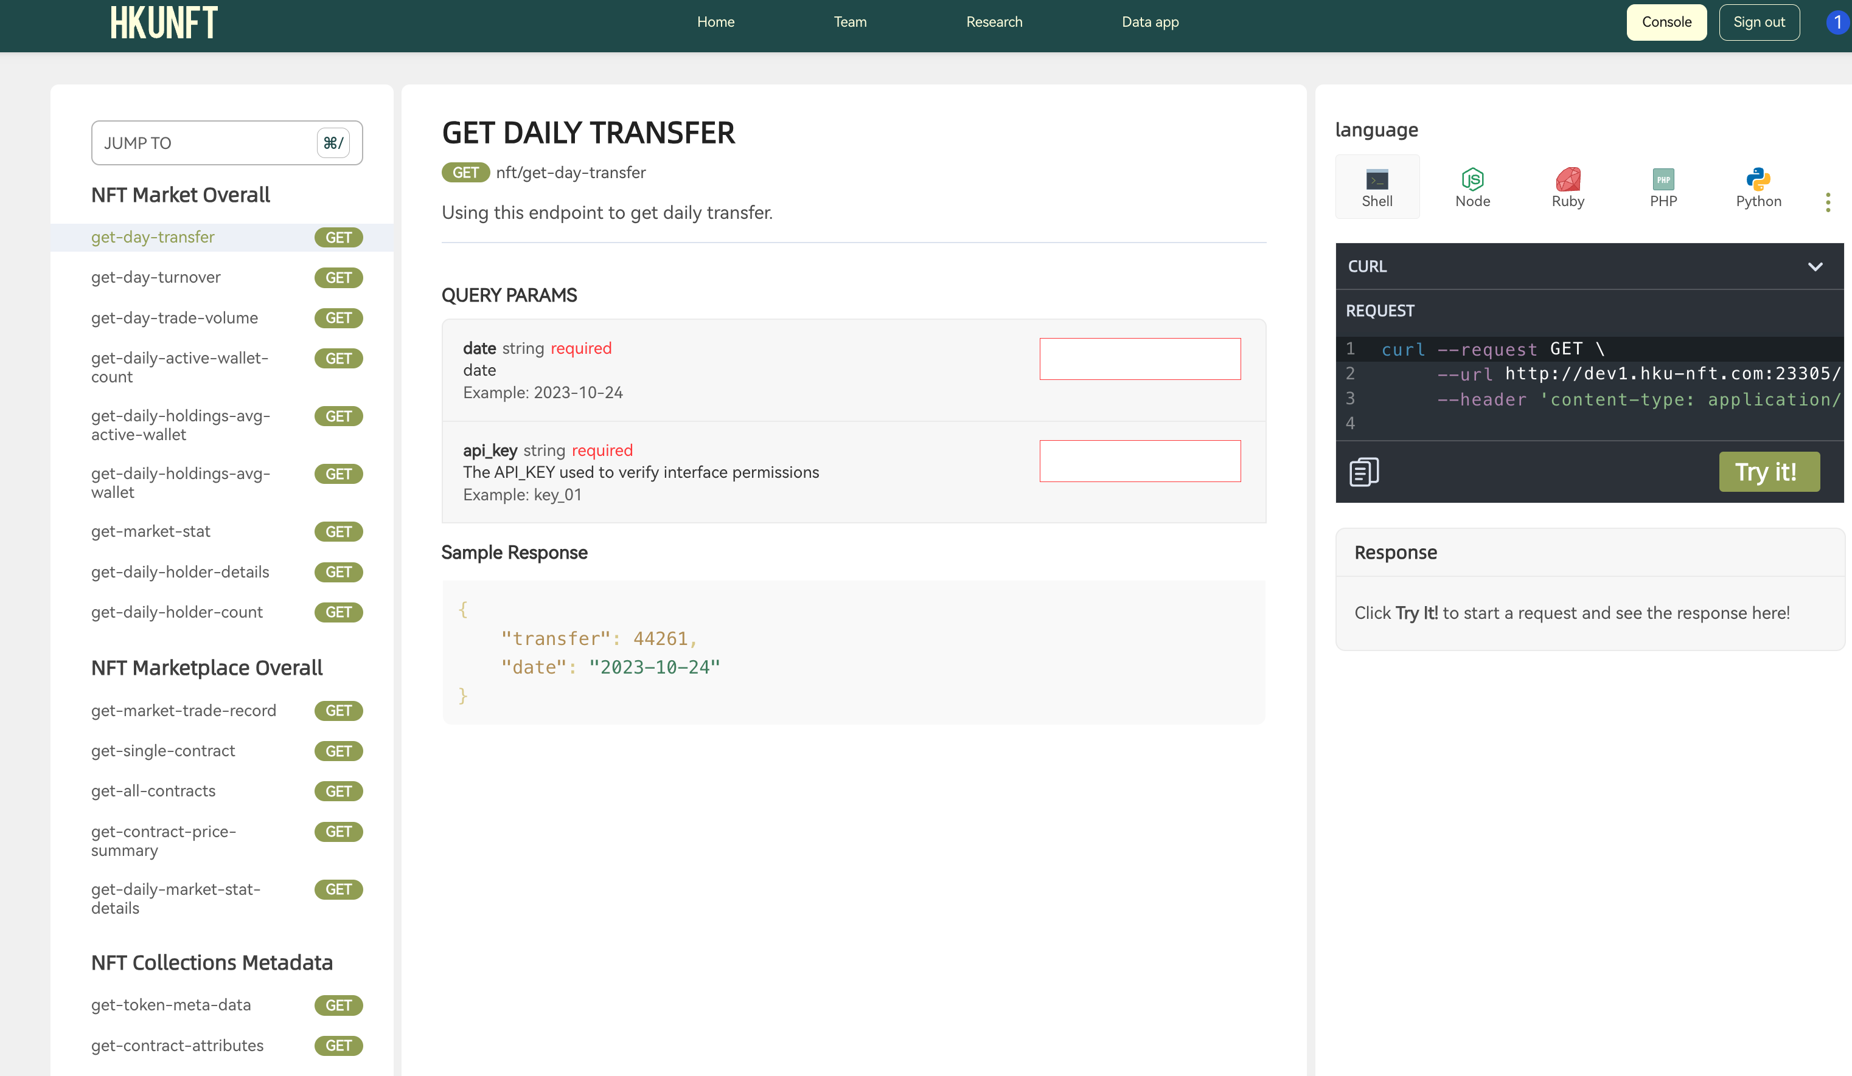
Customized Data Interface
APIs for Pro
Personalized API Keys
Seamless Integration

Slide 45
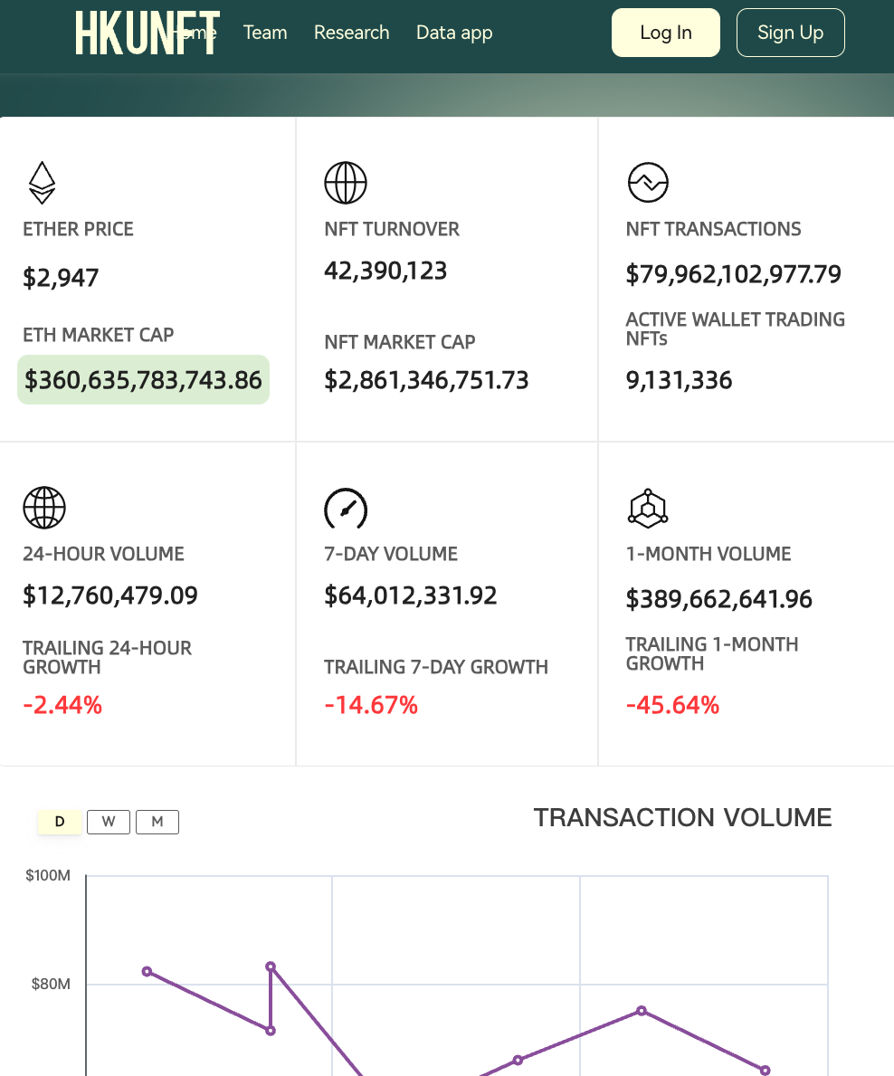
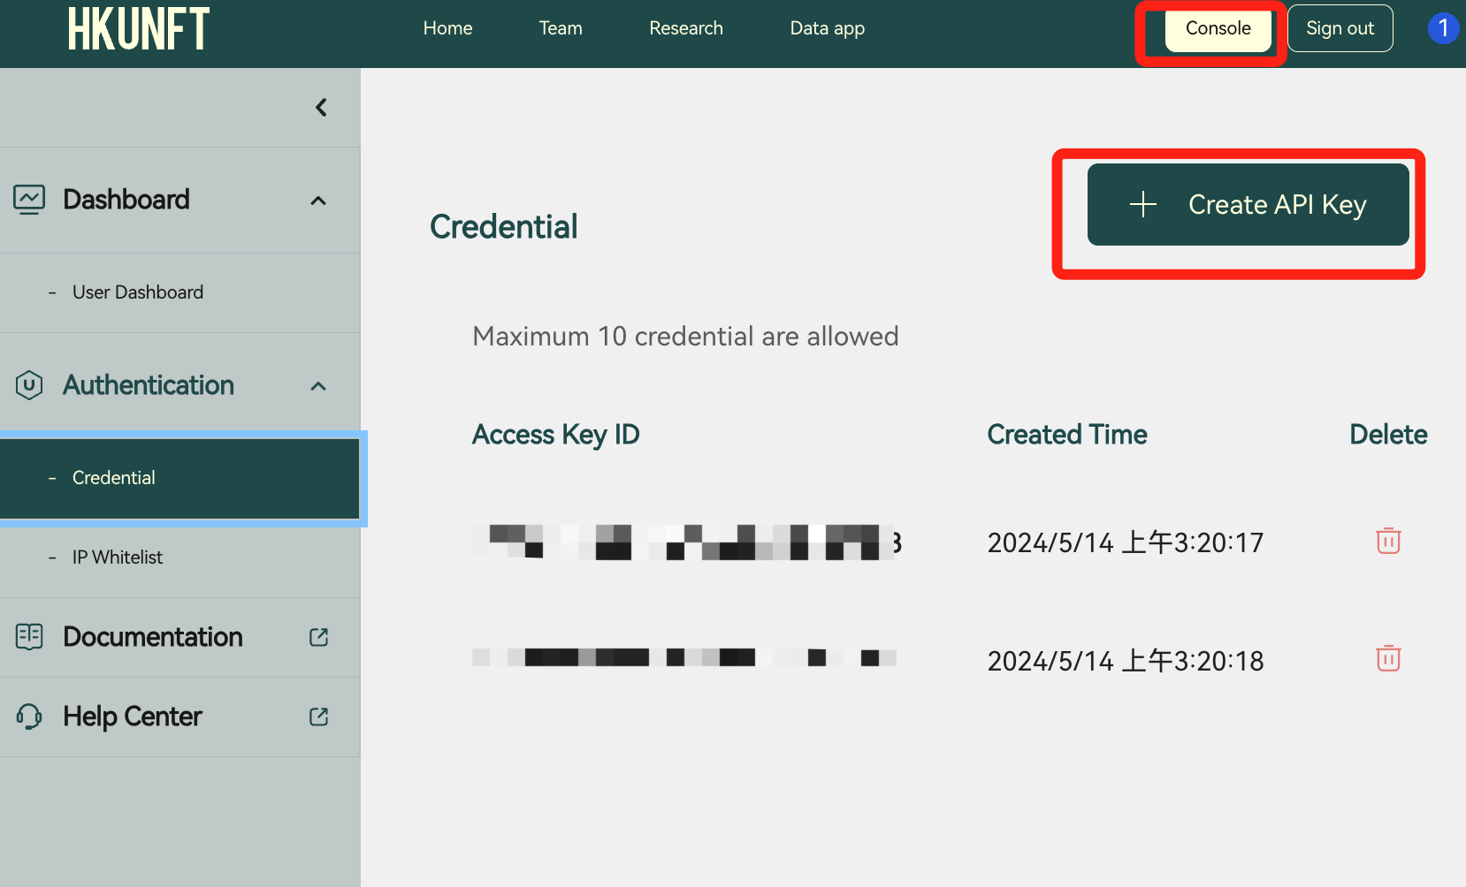
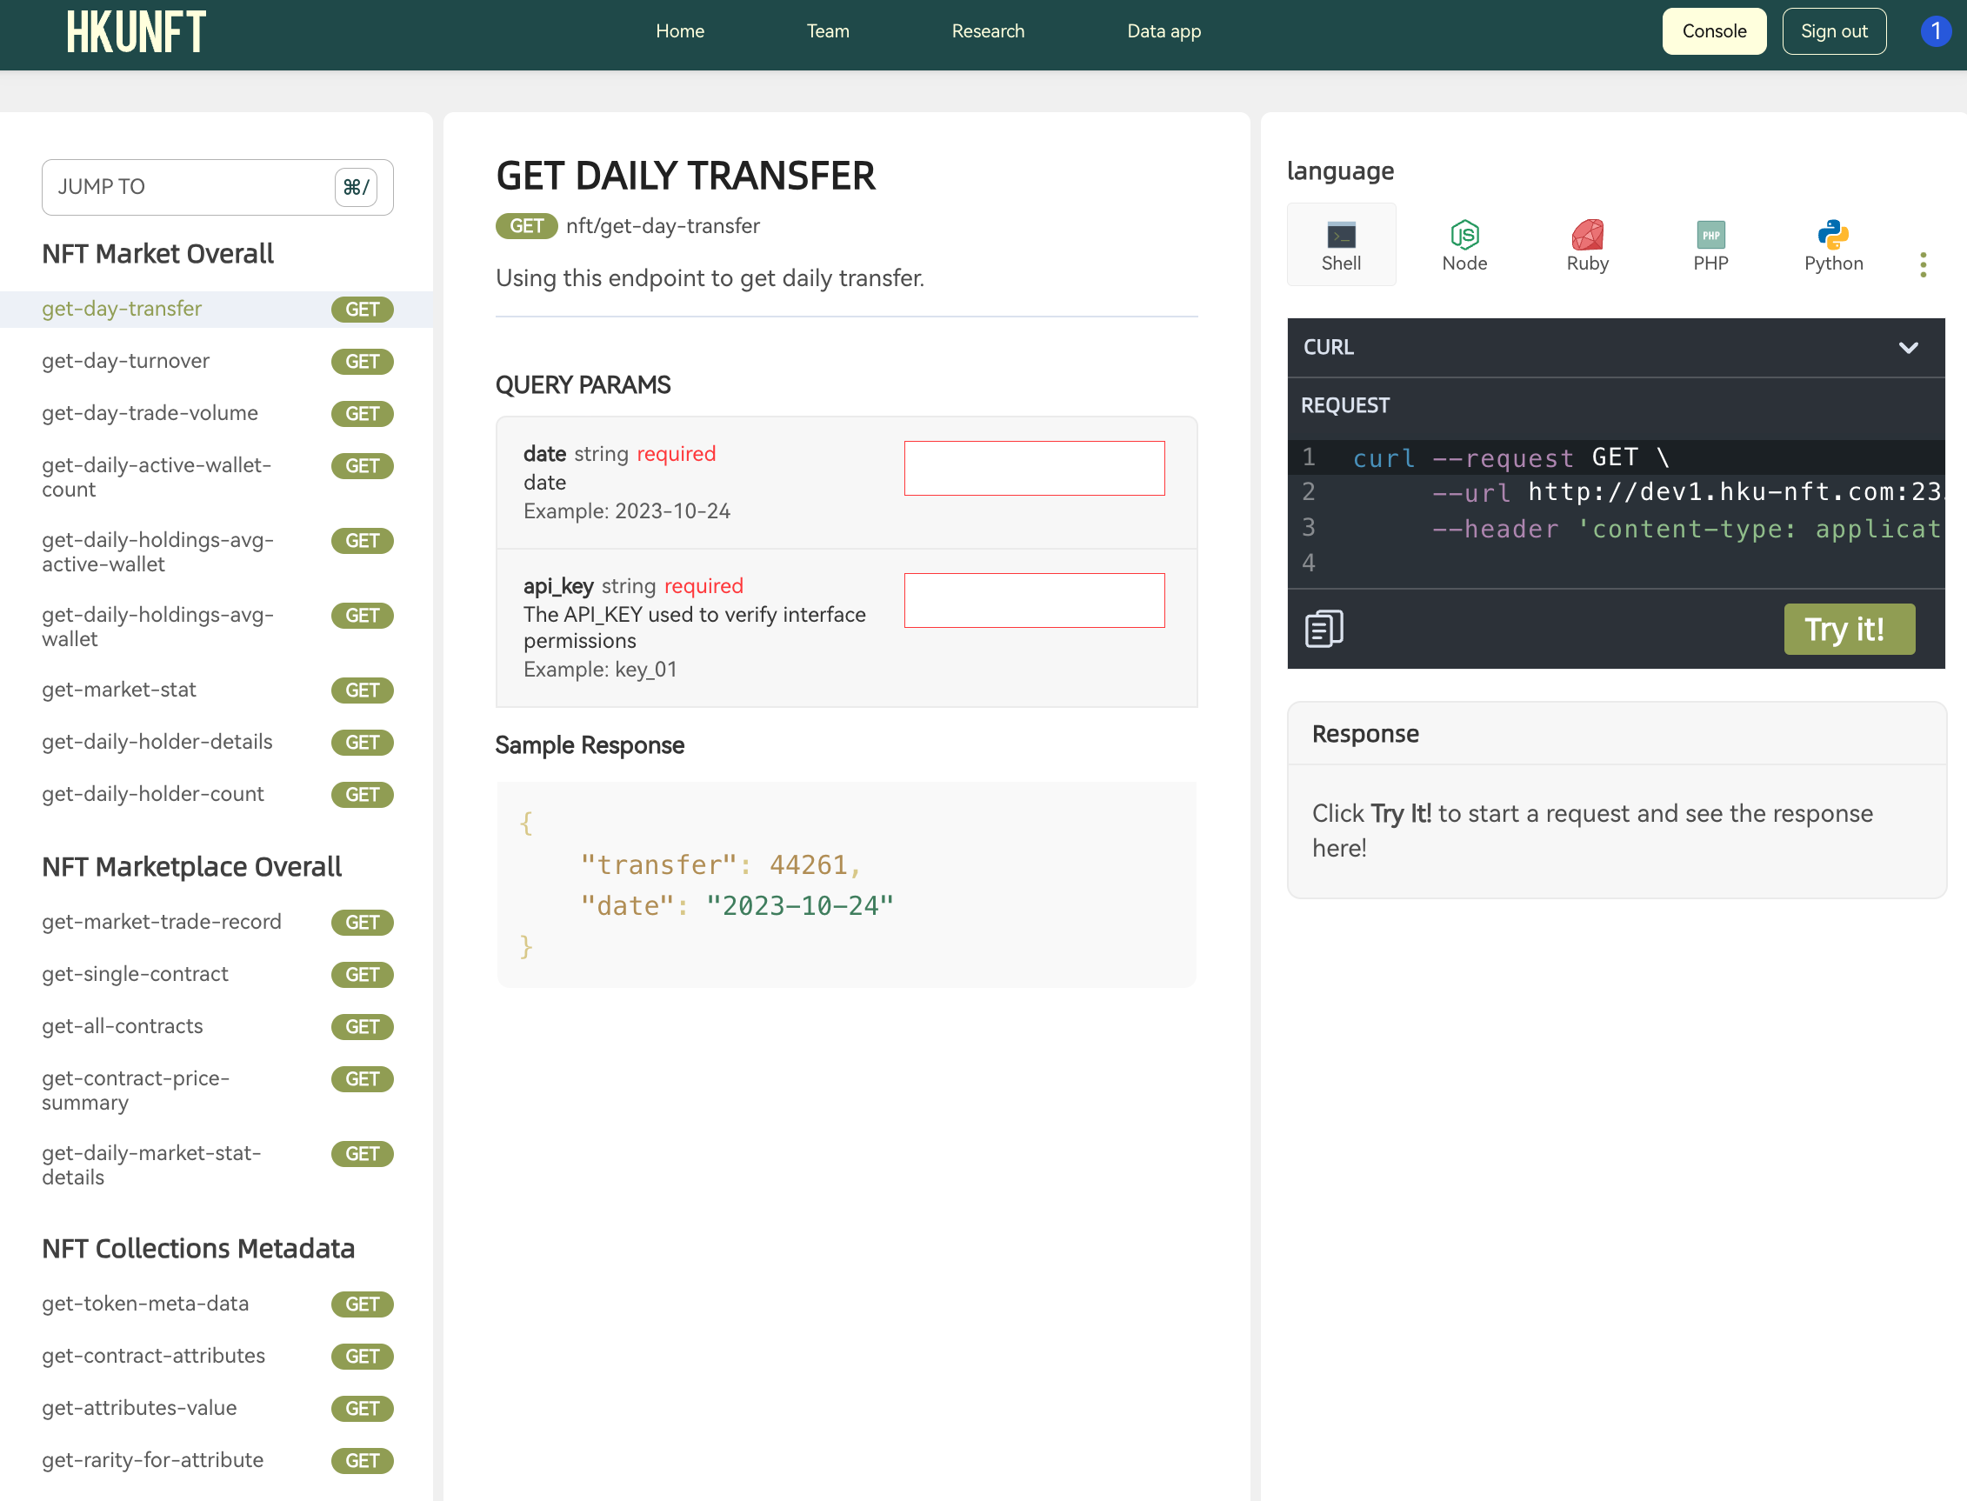
Customized Data Interface
APIs for Pro - A Step by Step Guide
1. Sign in
2. Enter the console and create your API key(keep it safe!)
3. Get cleaned NFT data

Slide 46
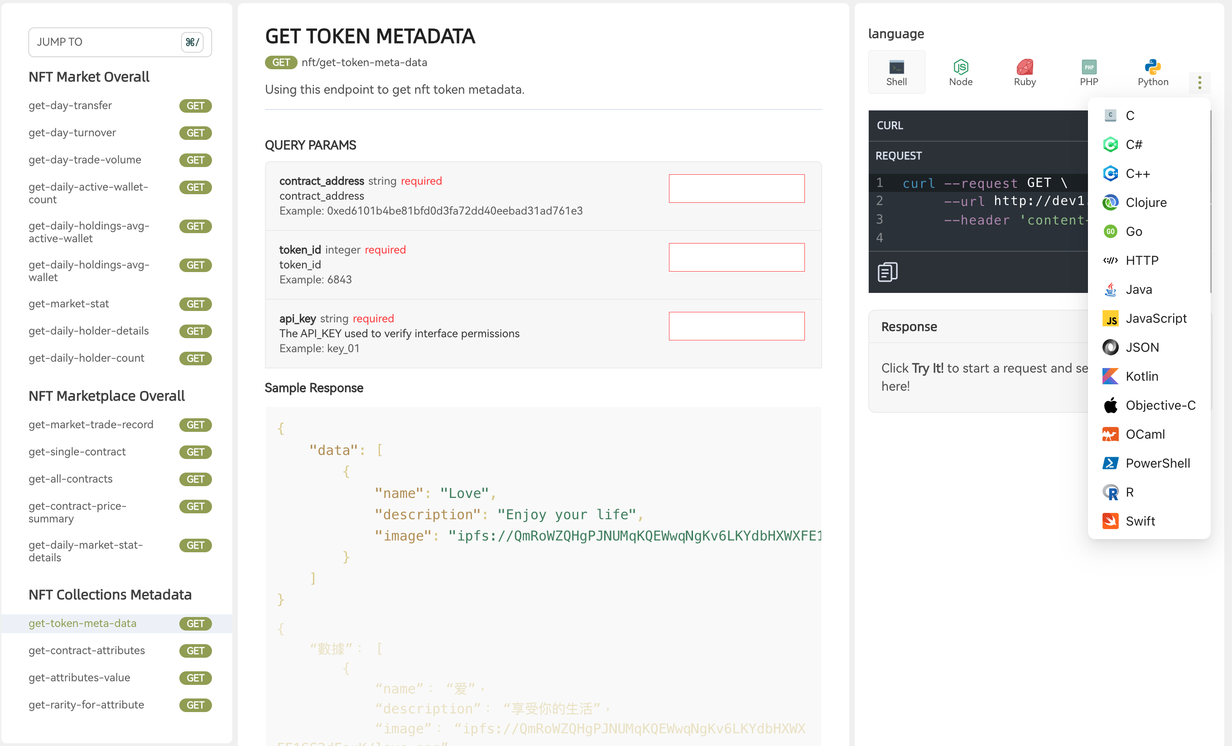
Customized Data Interface
APIs for Pro
20 Languages
18 Mtetrics
Filtered, Cleand, Augmented.

Slide 47
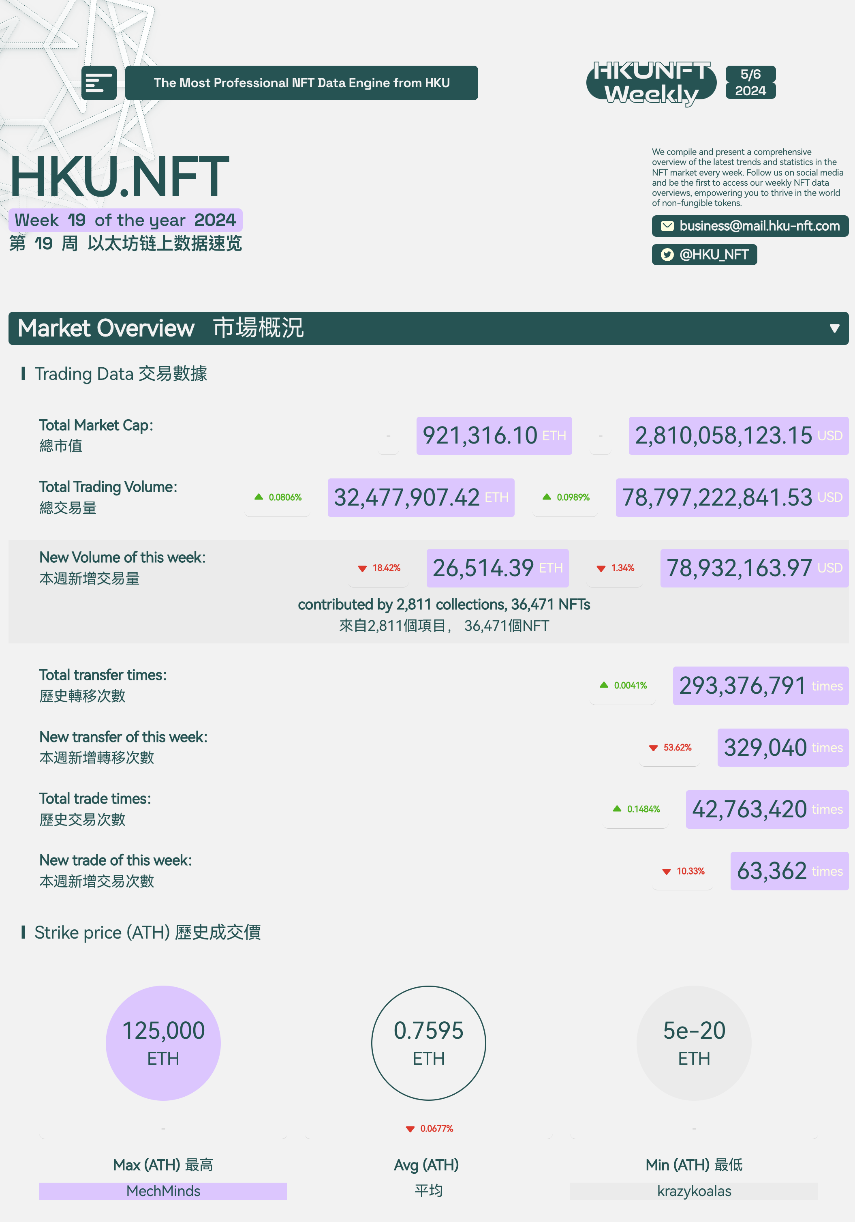
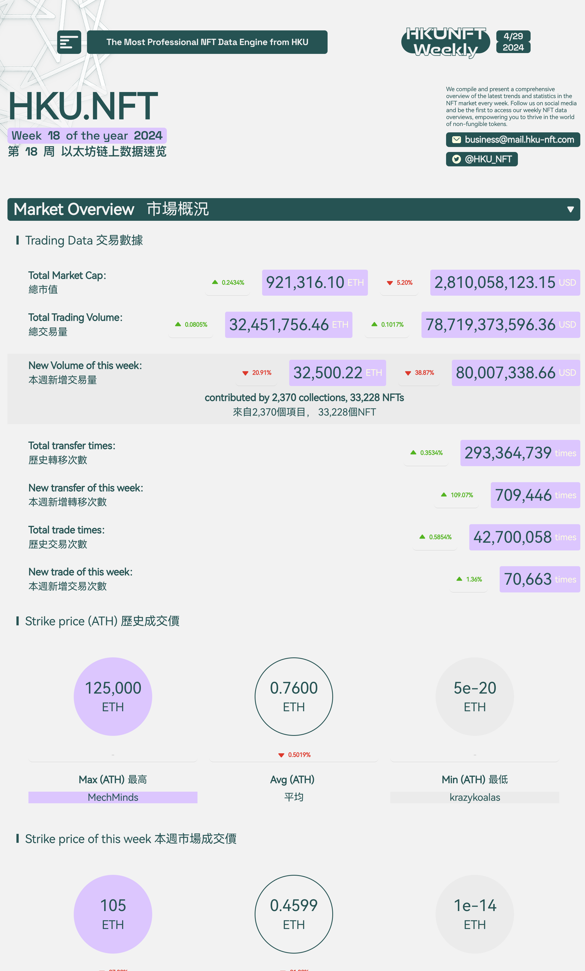
Customized Data Interface
In-depth Weekly NFT Report
Comprehensive Market Overview
Actionable Insights
Stay Ahead
Ideal for Decision-Makers

Slide 48
NFT Data Extract Analysis
Content
Block chain industry
Market vacancy
Bright prospect
Course introduction and design

Slide 49
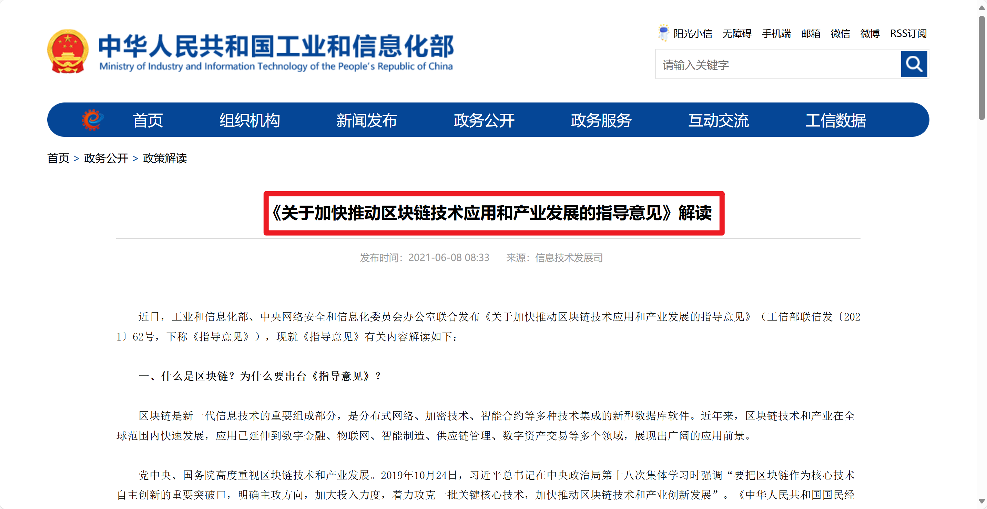

Slide 50
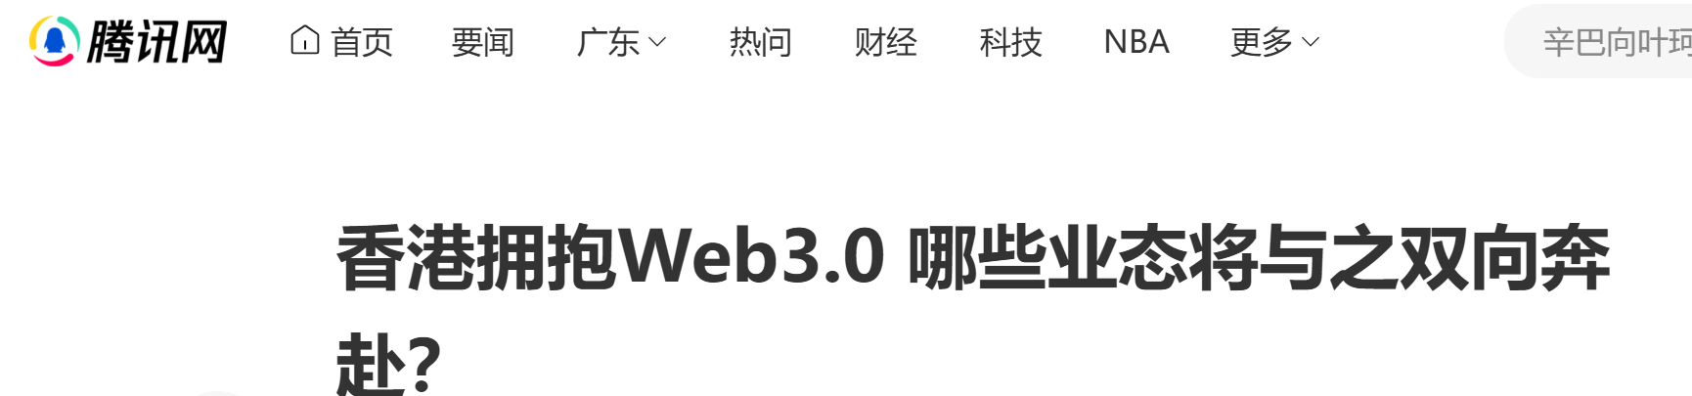
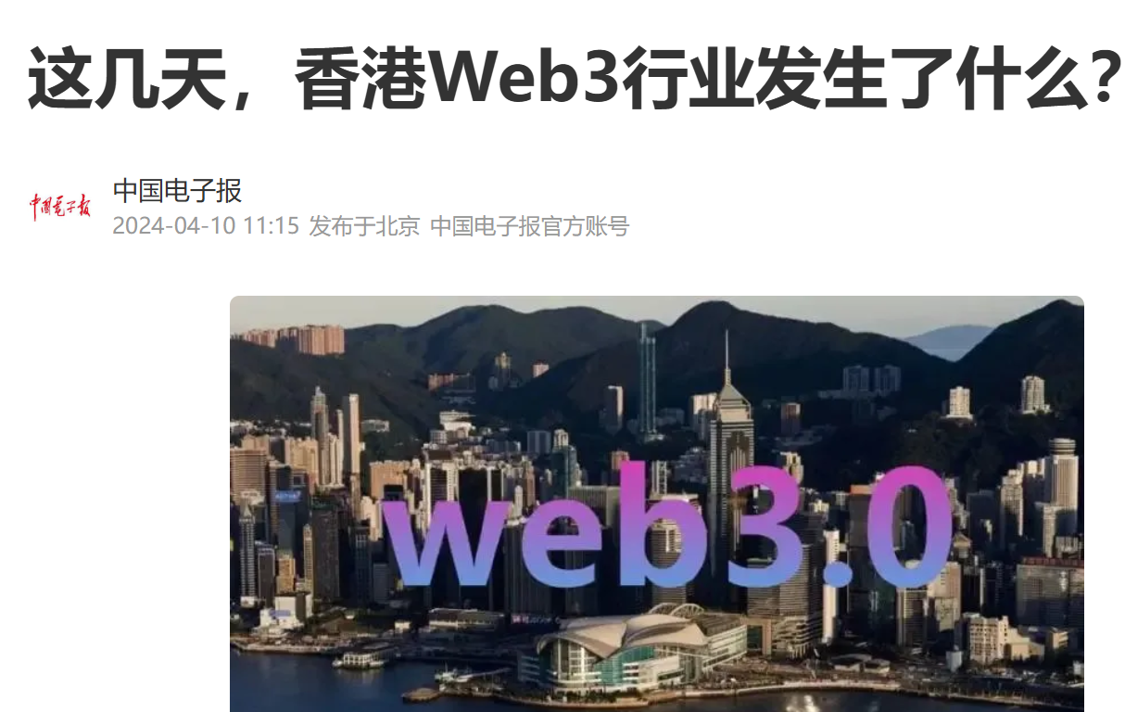
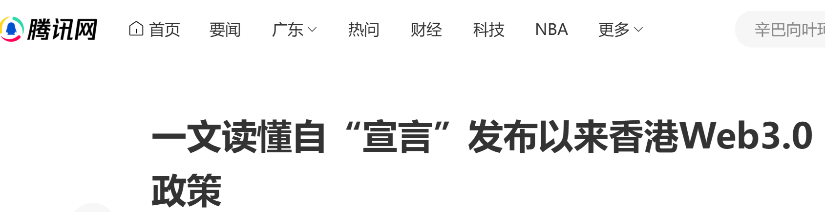

Slide 51
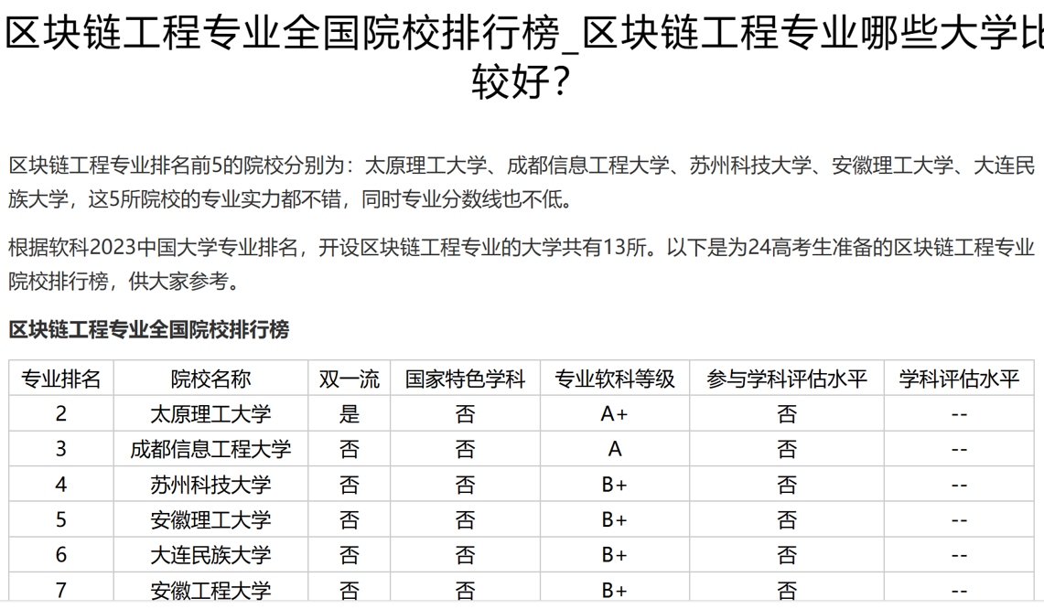
https://gaokao.eol.cn/zhiyuan/zhinan/202311/t20231121_2533978.shtml

Slide 52
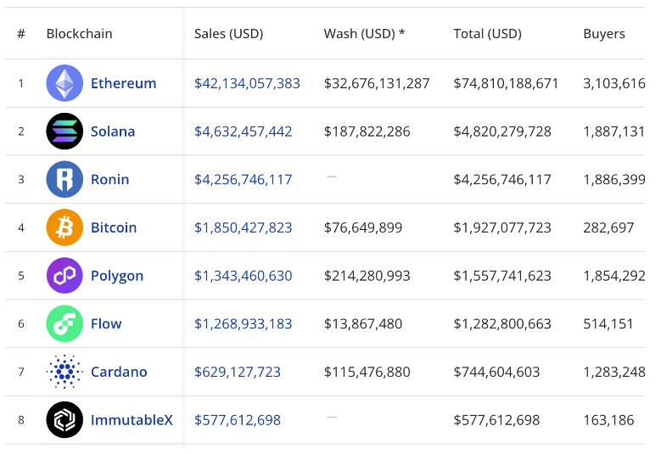
All TIME Blockchains by NFT Sales Volume
Bright prospect
Source:Cryptoslam

Slide 53
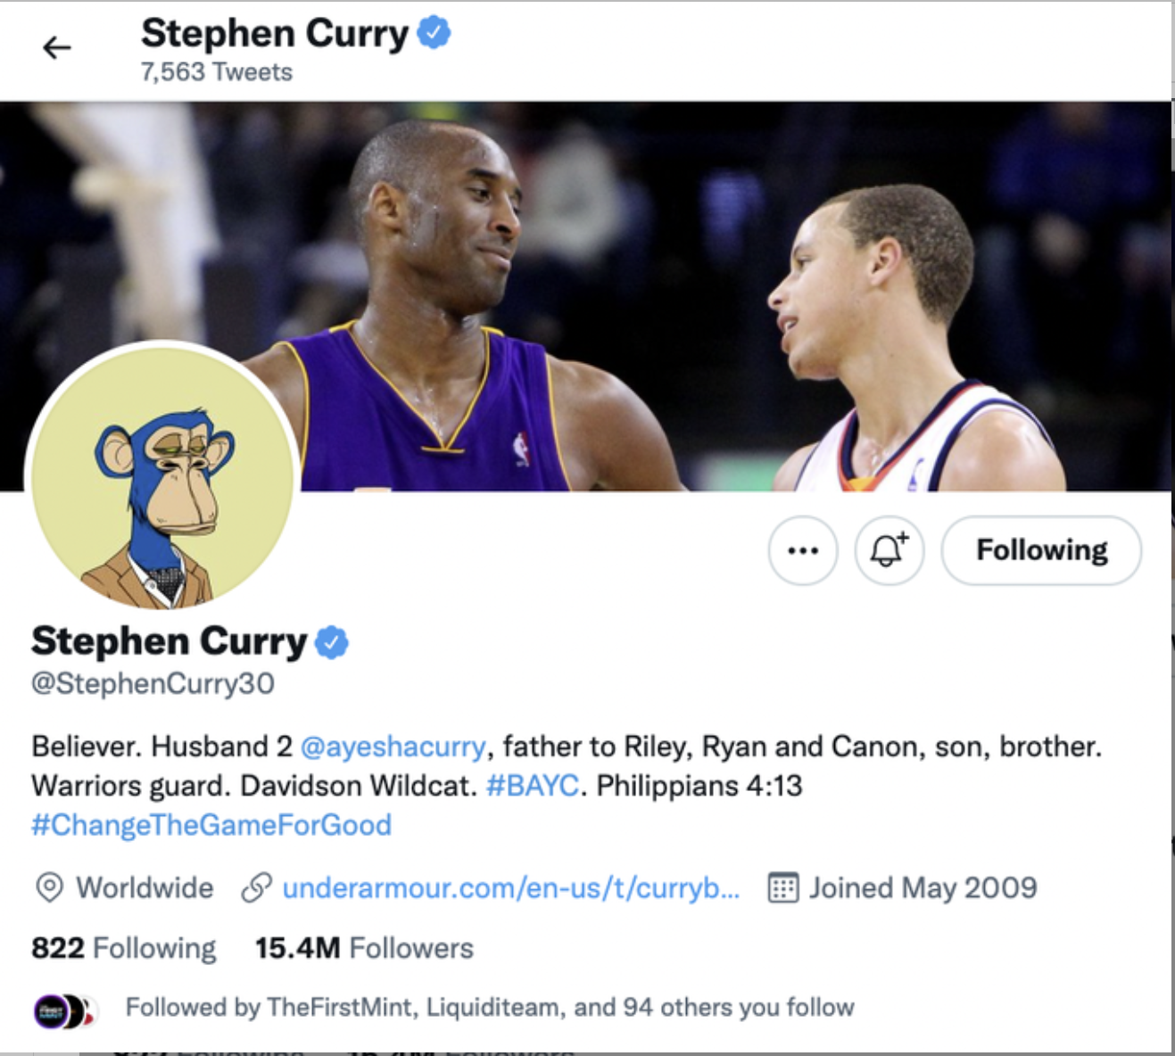
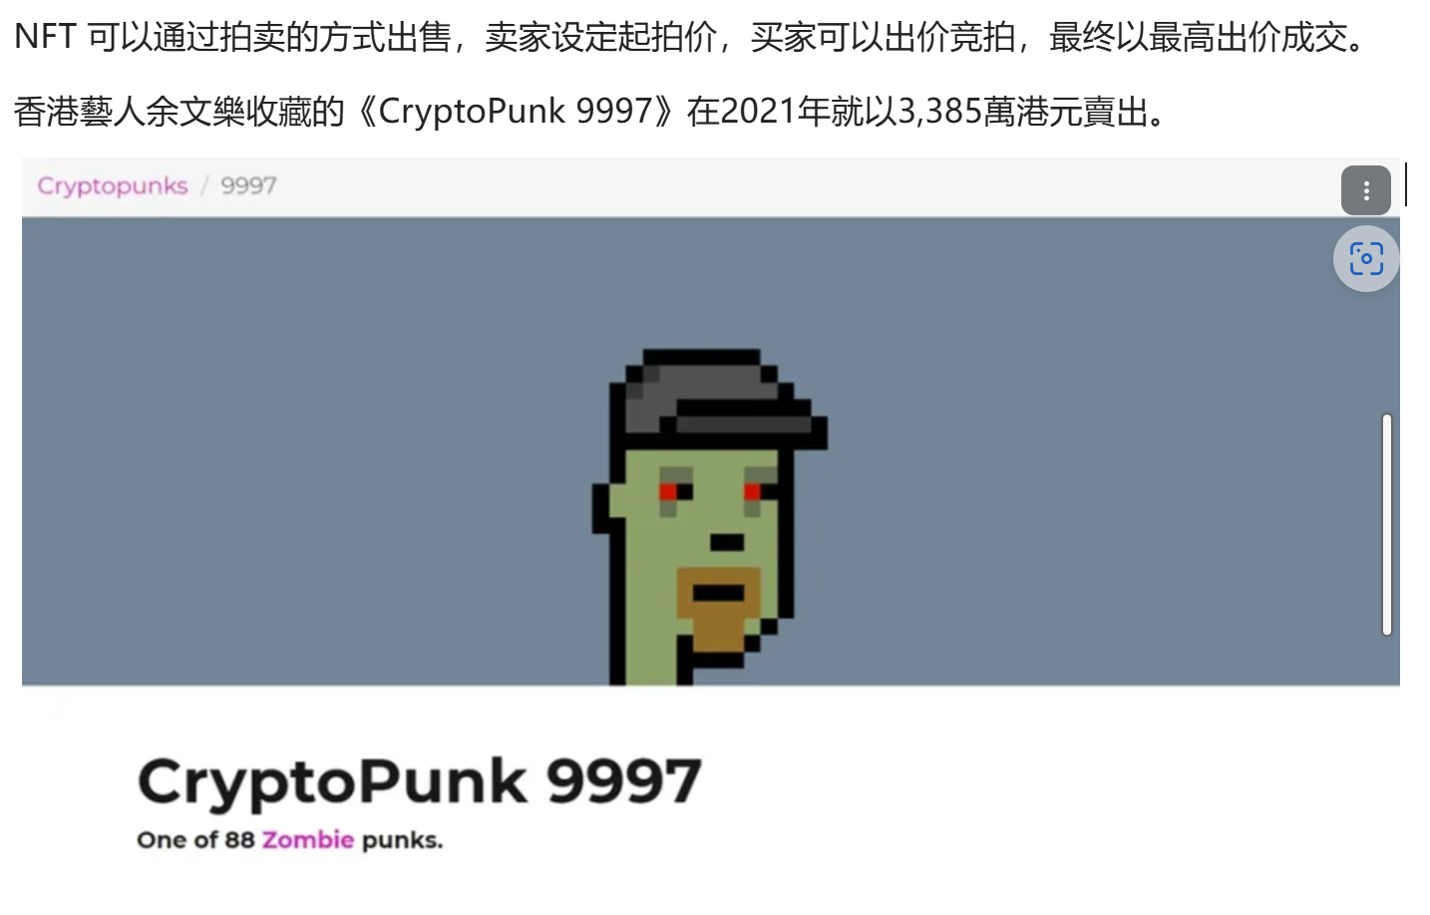
Celebrities’ NFT Holdings

Slide 54
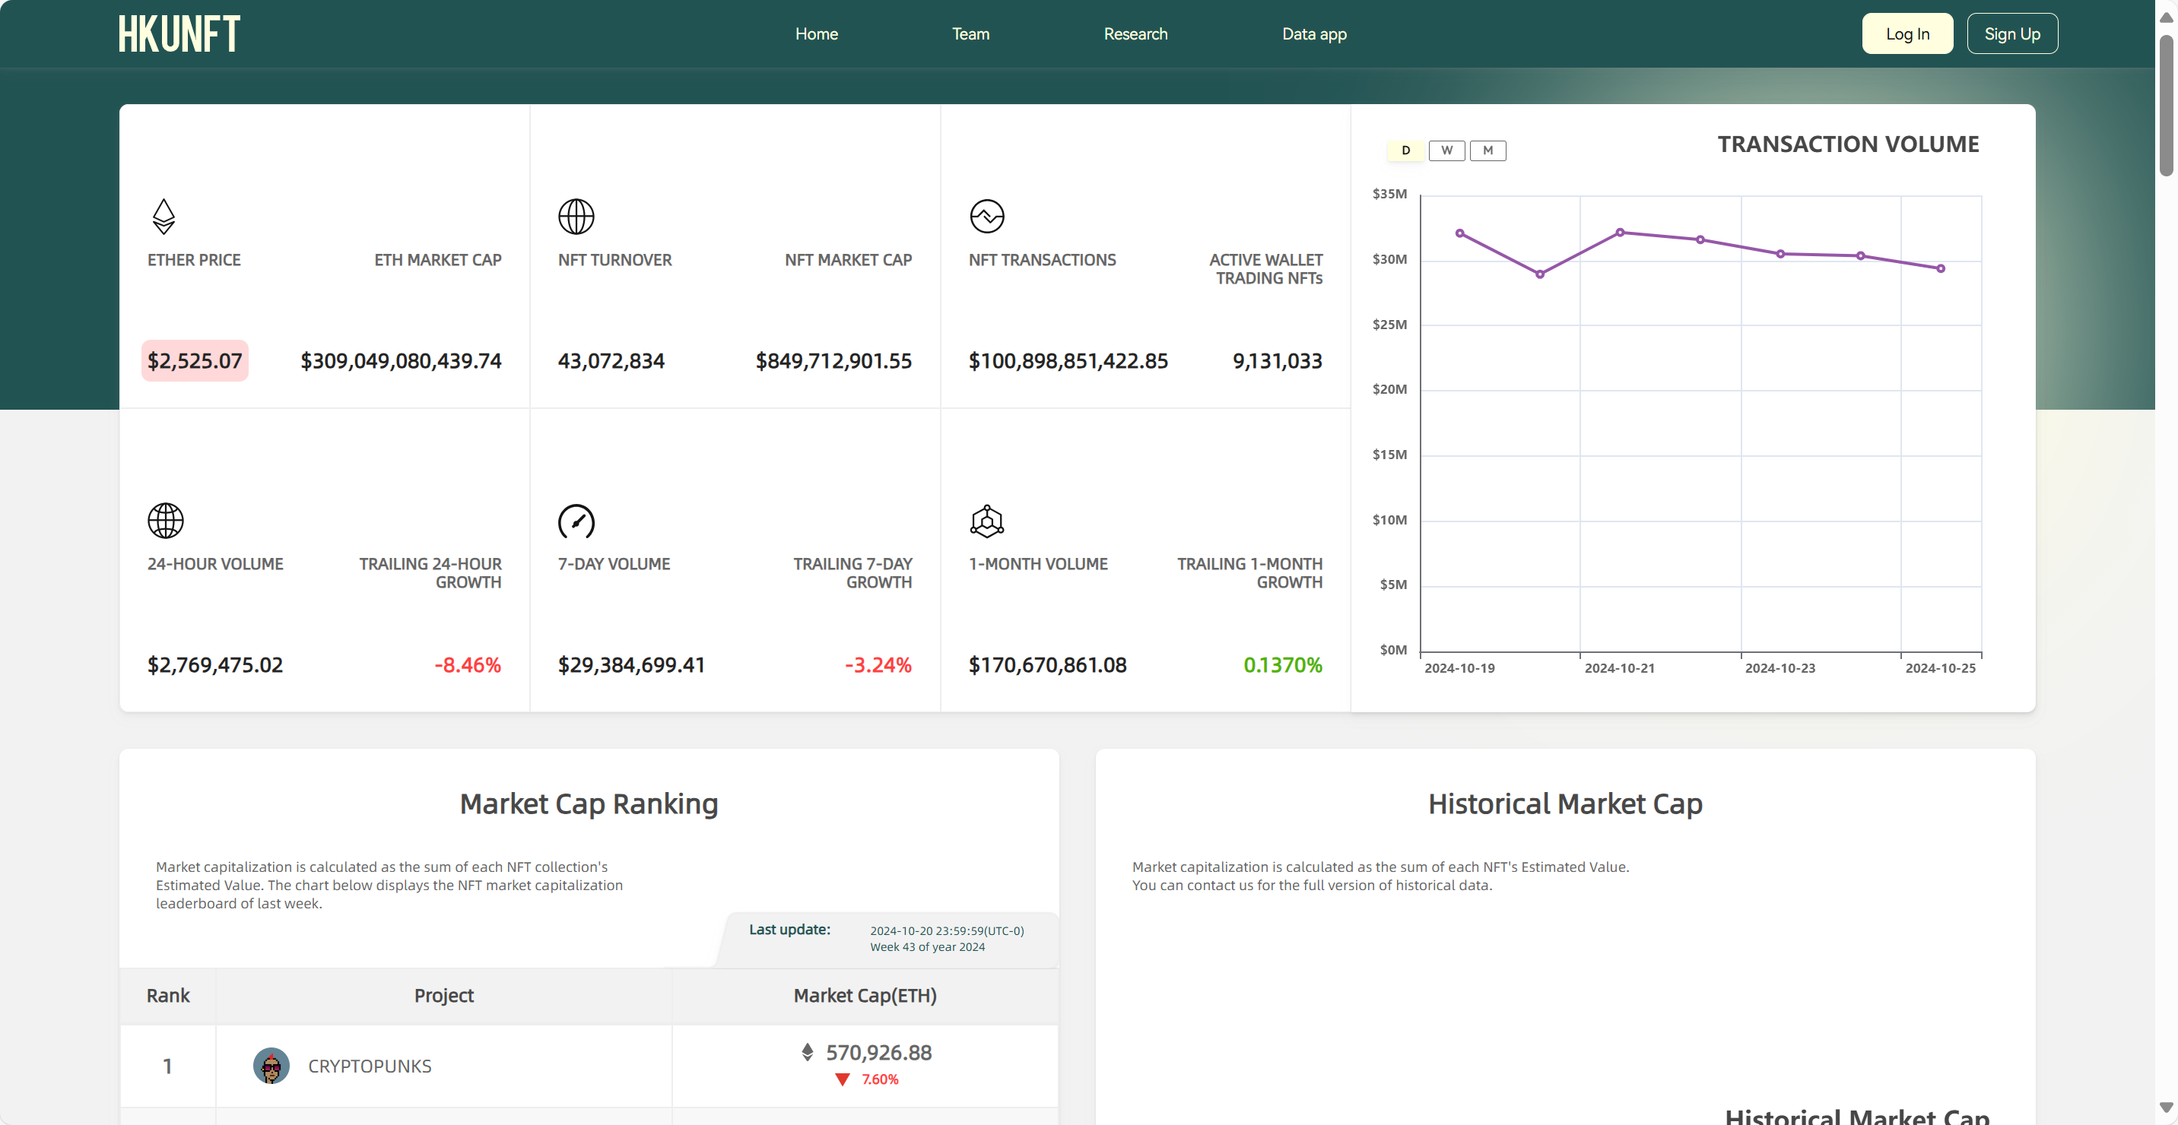

Slide 55
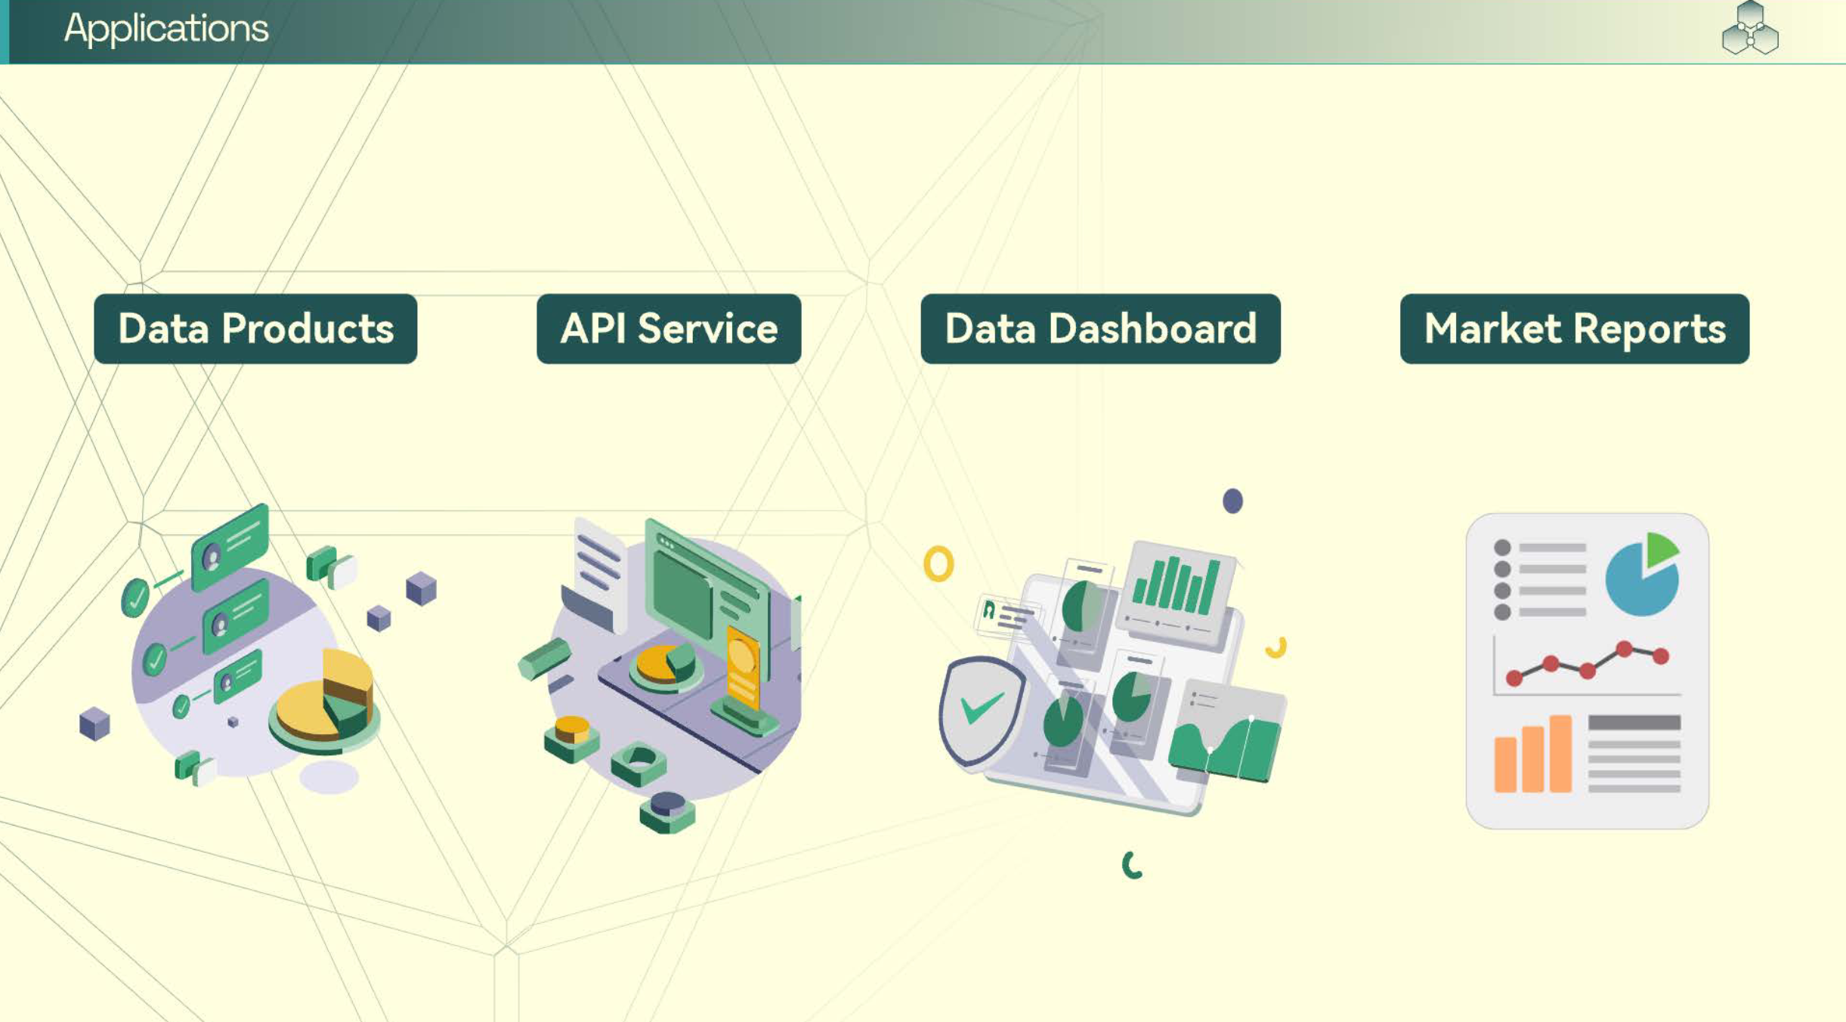

Slide 56




Comprehensive Data Insights
Financial Indicator Analysis:
Market Overview
Trading Volume
On-chain Transactions
Turnover

Slide 57



Slide 58
All-in-one NFT Data Analysis Platform
On-Chain Data
HKU NFT Data Analysis Platform
Developers
HKU-NFT
API
OpenSea
Raw Data
Filtered Data
Key Metrics
Blur
HKU-NFT
Dashboard
Analysts
X2Y2
Web3
Node
Logs
Topic
Token_id
Transfer
Address
Volume
Market Cap
Strike Price
Transactions
Active Wallets
Minting
...
LooksRare
Cleaned
Augmented
HKU-NFT
Weekly Report
Traders
Zora
HKU-NFT
Lecture
Newbies

Slide 59


Slide 60

HKUNFT Course

Slide 61

Market vacancy

Slide 62
Thank you!

